Slide 1


Learner Centered Teaching in Physics and Astronomy
Dr. Edward Prather
University of Arizona
Center for Astronomy Education (CAE)
http://astronomy101.jpl.nasa.gov

Slide 2
Collaboration of Astronomy Teaching Scholars (CATS)
Leilani Arthurs, UNL
Duncan Brown, Syracuse Univ.
Sanlyn Buxner, Univ. of Arizona
David Consiglio, Bryn Mawr College
Tim Chambers, U Michigan
Steve Desch, Guilford Tech. CC
Doug Duncan, CU Boulder
Jeffrey Eckenrode, Pacific Science CTR
Tom English, Guilford Tech. CC
John Feldmeier, Youngstown State Univ.
Amy Forestell, SUNY New Paltz
Rica French, MiraCosta College
Adrienne Gauthier, Dartmouth
Pamela Gay, SIU-Edwardsville
Dennis Hands, High Point Univ.
Kevin Hardegree-Ullman, University of Toledo
Melissa Hayes-Gehrke, Univ. of Maryland
Seth Horstein, CU Boulder
David Hudgins, Rockhurst Univ.
Chris Impey, Univ. of Arizona
Julia Kamenetzky, Univ of Arizona
Jessica Kapp, Univ. of Arizona
John Keller, Cal Poly SLO
Julia Kregenow, Penn State
Michelle Wooten, Univ of Alabama
Kevin Lee, UNL & NSF
Patrick Len, Cuesta College
Chris Lintott, Univ. of Oxford
Michael LoPresto, Henry Ford CC
Daniel Loranz, Truckee Meadows CC
Julie Lutz, Univ. of Washington
Danny Martino, Santiago Canyon College
Benjamin Mendelsohn, West Valley College
Ed Montiel, Louisiana State University
Peter Newbury, Univ. of British Columbia
Lee Powell, UN Kearney
Matthew Price, Ithaca College
Jordan Raddick, Johns Hopkins Univ.
Alex Rudolph, Cal Poly - Pomona
Travis Rector, Univ. of Alaska
Paul Robinson, Westchester CC
Wayne Schlingman, Ohio State
Sébastien Cormier, San Diego College
Colin Wallace, UNC
Kathryn Williamson, NRAO
James Wysong Jr., Hillsborough CC
Todd Young, Wayne St. College

Slide 3
Take Home Messages
Research-validated interactive learning strategies can benefit ALL students in ALL classroom environment - BUT
The quality of our implementation is likely the most deterministic factor toward student achievement

Slide 4
CAE National Study
Almost 4000 students
31 institutions
36 instructors
69 different sections
  Section sizes vary from <10 to 180
  (now with sections >750!)

Slide 5
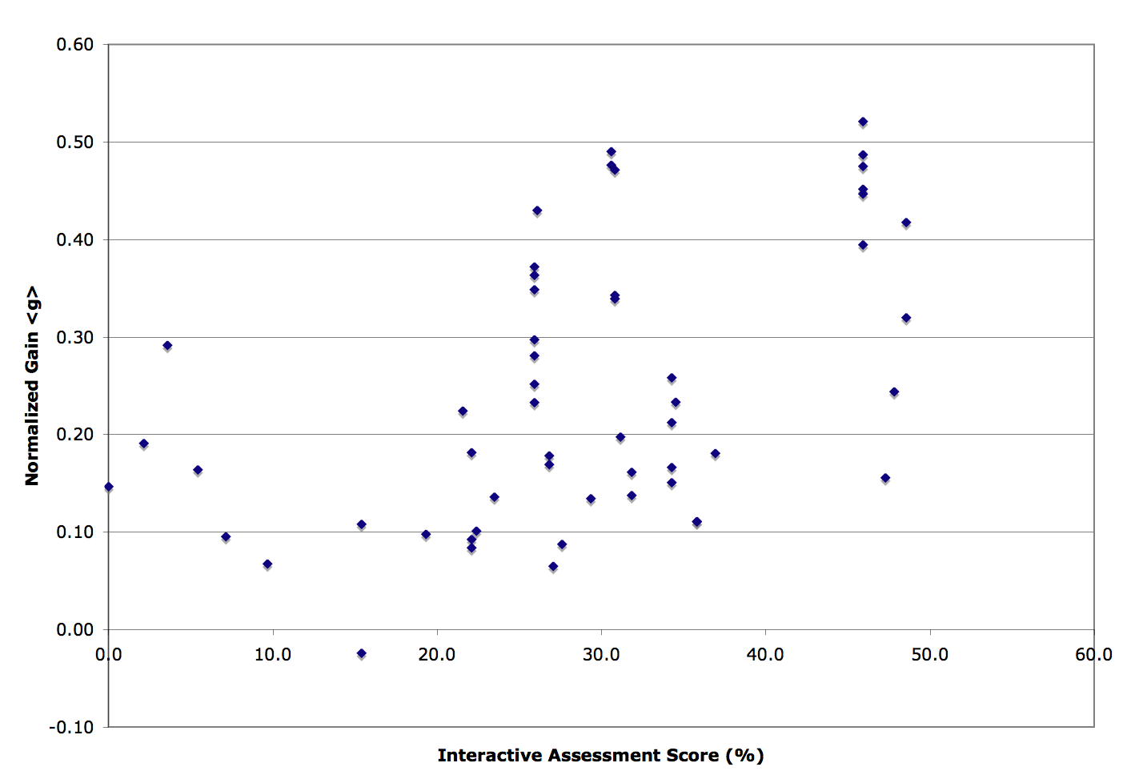

Slide 6
Medium level <g> > 0.30

Slide 7

Just the tip of the iceberg of what it takes to create a highly functioning interactive engagement classroom

Slide 8
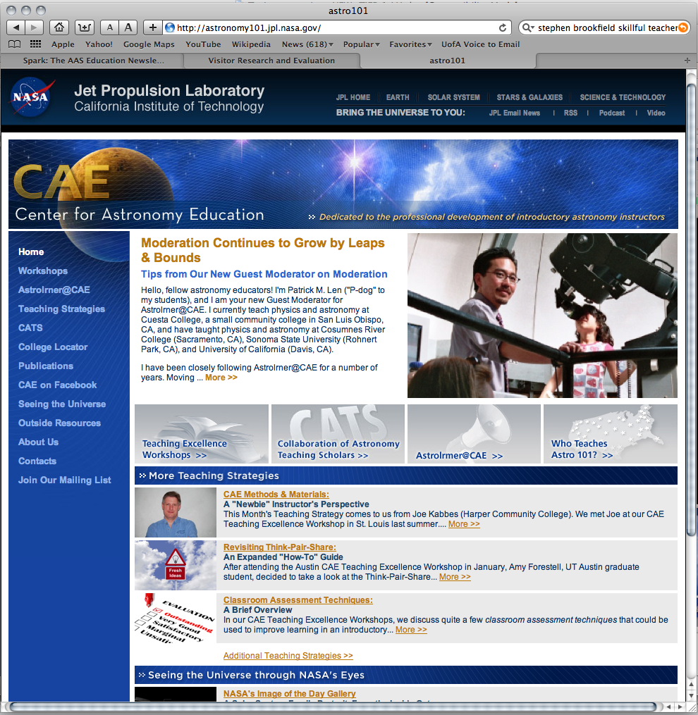

Slide 9
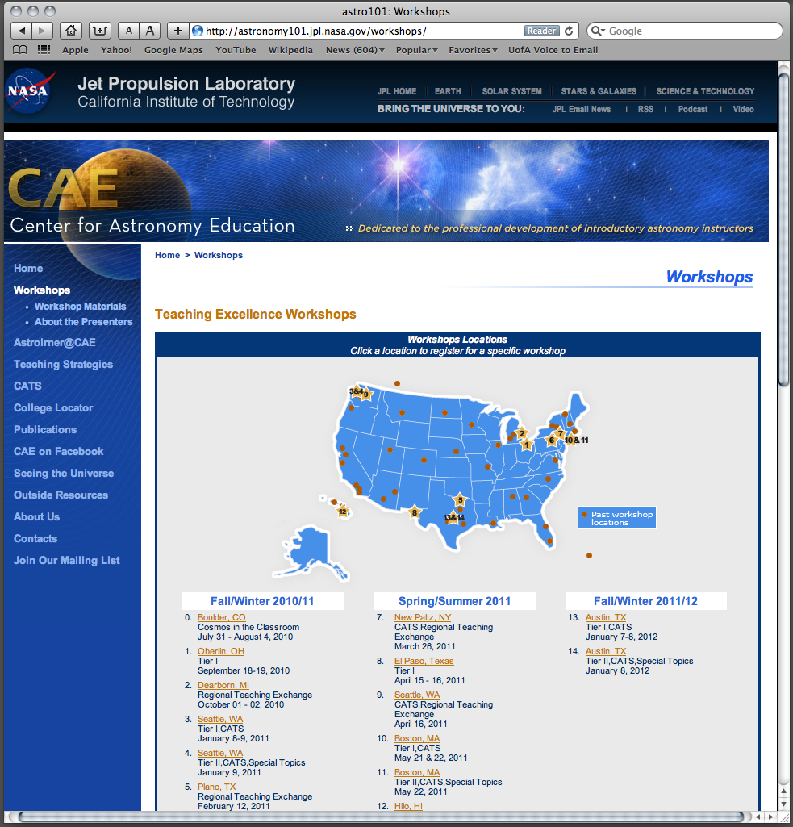
Astronomy101.jpl.nasa.gov/workshops

Slide 10
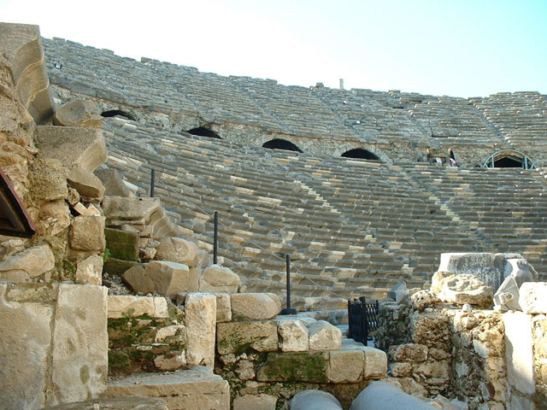

“Most ideas about teaching are not new, but not everyone knows the old ideas.” Euclid (300 B.C.)

Slide 11


Slide 12
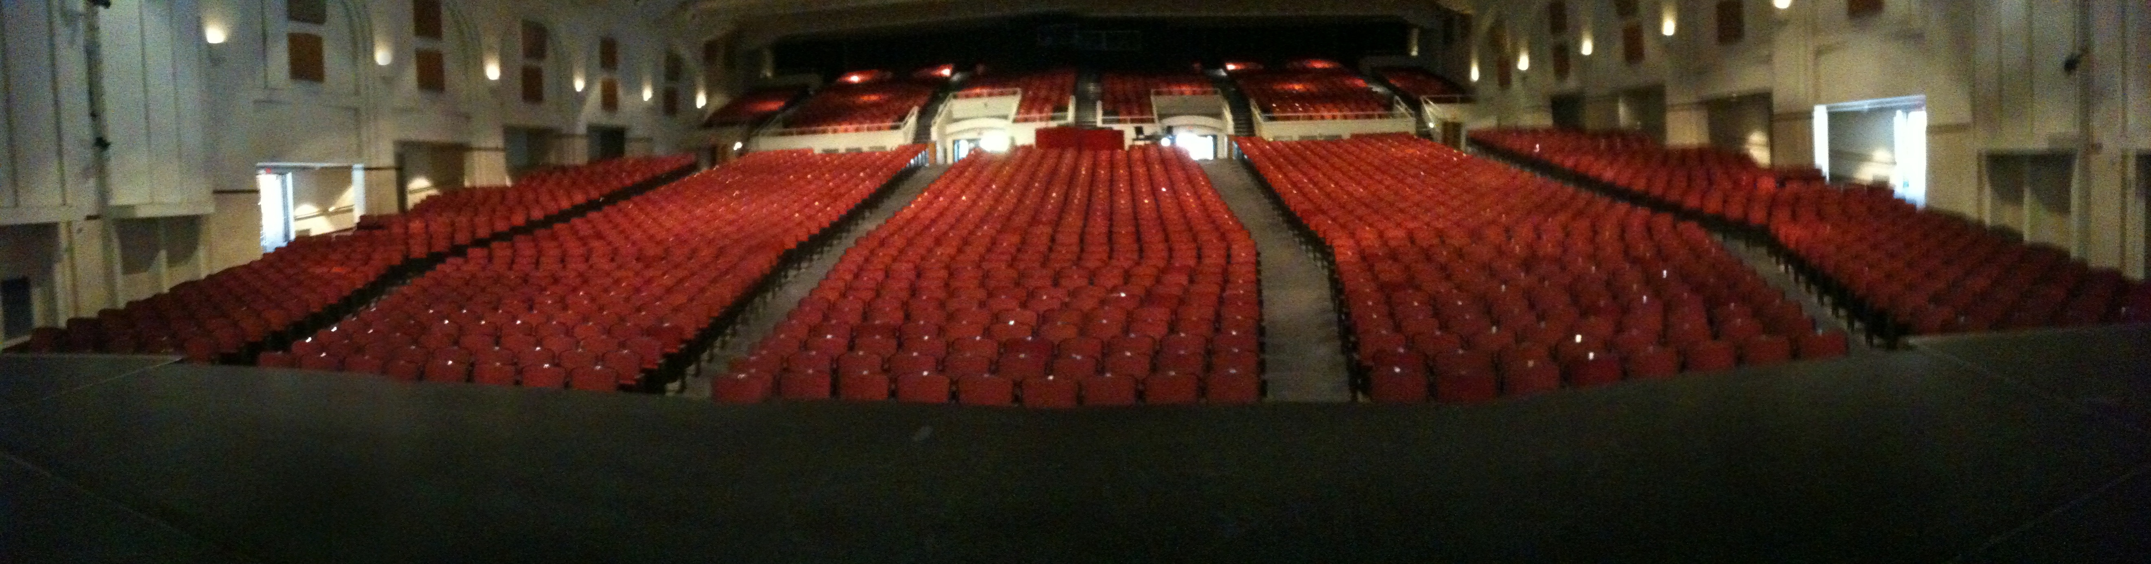
Centennial Hall Performing Arts Theater at University of Arizona

Slide 13
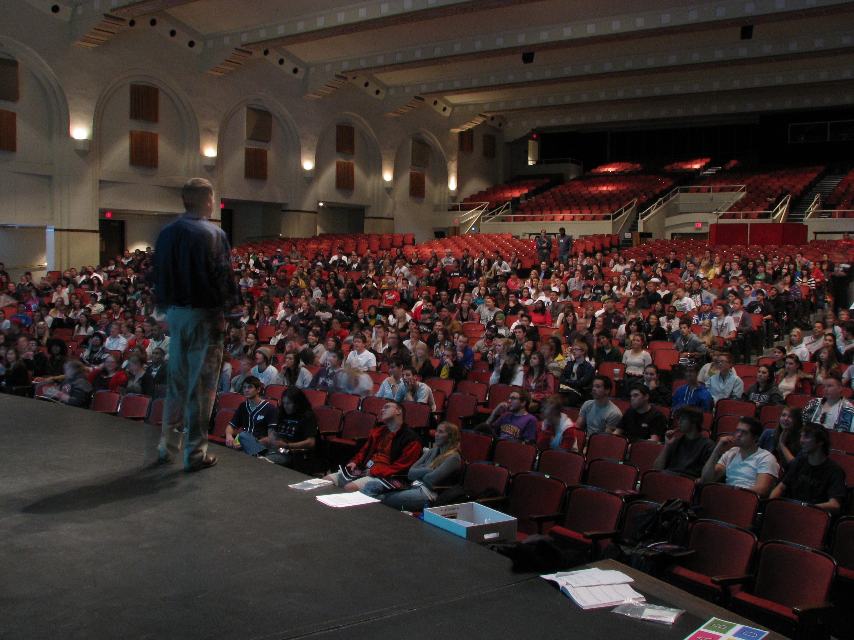

Slide 14
Perspectives on Teaching in the Active Learning Environment
“I’m comfortable engaging with my students.”
“I know how to get my students to intellectually engage in critical reasoning and problem solving.”
“I know how to create highly interactive learning environments that get all my students collaborating.”
“I know what to do when my students get stuck.”
“I know how to handle a group that is asking for answers.”
“I know how to handle a group that is not collaborating.”
etc., etc., etc…
Notes:
NO VOTE. Use voting cards to vote on PCK knowledge from A=I could give a departmental talk about it t→ E=I never heard those ideas before.

Slide 15
What Can I do Besides Lecture to Engage Students in their Learning?
Ask students questions (not all questions are equal)
Use interactive videos, demonstrations, animations, and simulations
In-class writing (with or without discussion)
  Muddiest Point
  Summary of Today's Main Points
  Writing Reflections
  Think-Pair-Share or Peer Instruction
Small Group Interactions
  Concept Maps
  Case Studies
  Sorting Tasks
  Ranking Tasks
  Lecture-Tutorials
Student Debates (individual/group)
Whole Class Discussions

Slide 16
Does your class intellectually engage your students and deepen their conceptual understanding and critical thinking ability or does it reinforce the memorization of facts and declarative knowledge?
Bloom’s Taxonomy of Educational Objectives
evaluation
synthesis
analysis
application
comprehension
declarative knowledge

Slide 17
If a Picture is worth a thousand words, then what is a real-world, first-hand, experience worth?
Please participate in the role of a good student!
Don’t get stuck or caught up in thinking like a PHD Physicist or Astronomer!!!!!
“Eventually, Billy came to dread his father’s lectures over all other forms of punishment”
Notes:
Should be at 1:30
Seth leads here.
Take a deep breath, the lecture portion of the workshop is over. So to do that we need your participation
If we ask you to talk to your neighbor

Slide 18
Todays Topic:
“Motion of Extrasolar Planets”
Please pay attention to:
The sequencing of different instructional strategies
The different implementation methods used
How feedback was incorporated
How collaboration was encouraged and motivated
Notes:
Paul introduces the lecture

Slide 19
Tutorial:
Motion of Extrasolar Planets
Work with a partner!
Read the instructions and questions carefully.
Discuss the concepts and your answers with one another. Take time to understand it now!!!!
Come to a consensus answer you both agree on.
If you get stuck or are not sure of your answer, ask another group.

Slide 20
CAE National Study
Almost 4000 students
31 institutions
36 instructors
69 different sections
  Section sizes vary from <10 to 180
  (now with sections >750!)

Slide 21
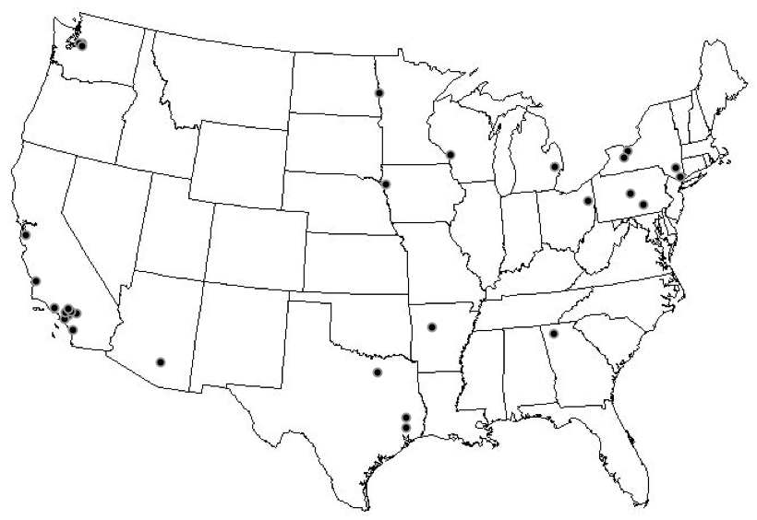
This was a truly national study

Slide 22
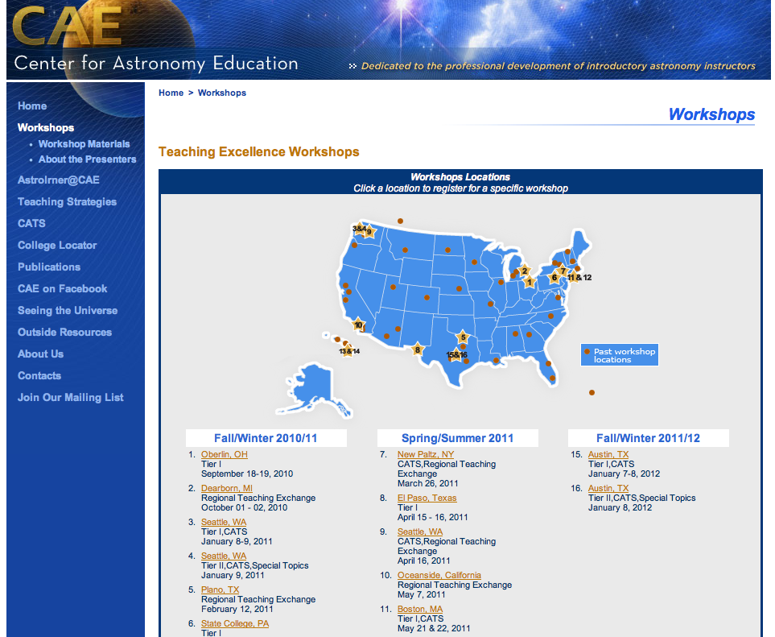
CAE National Professional Development Program

Slide 23
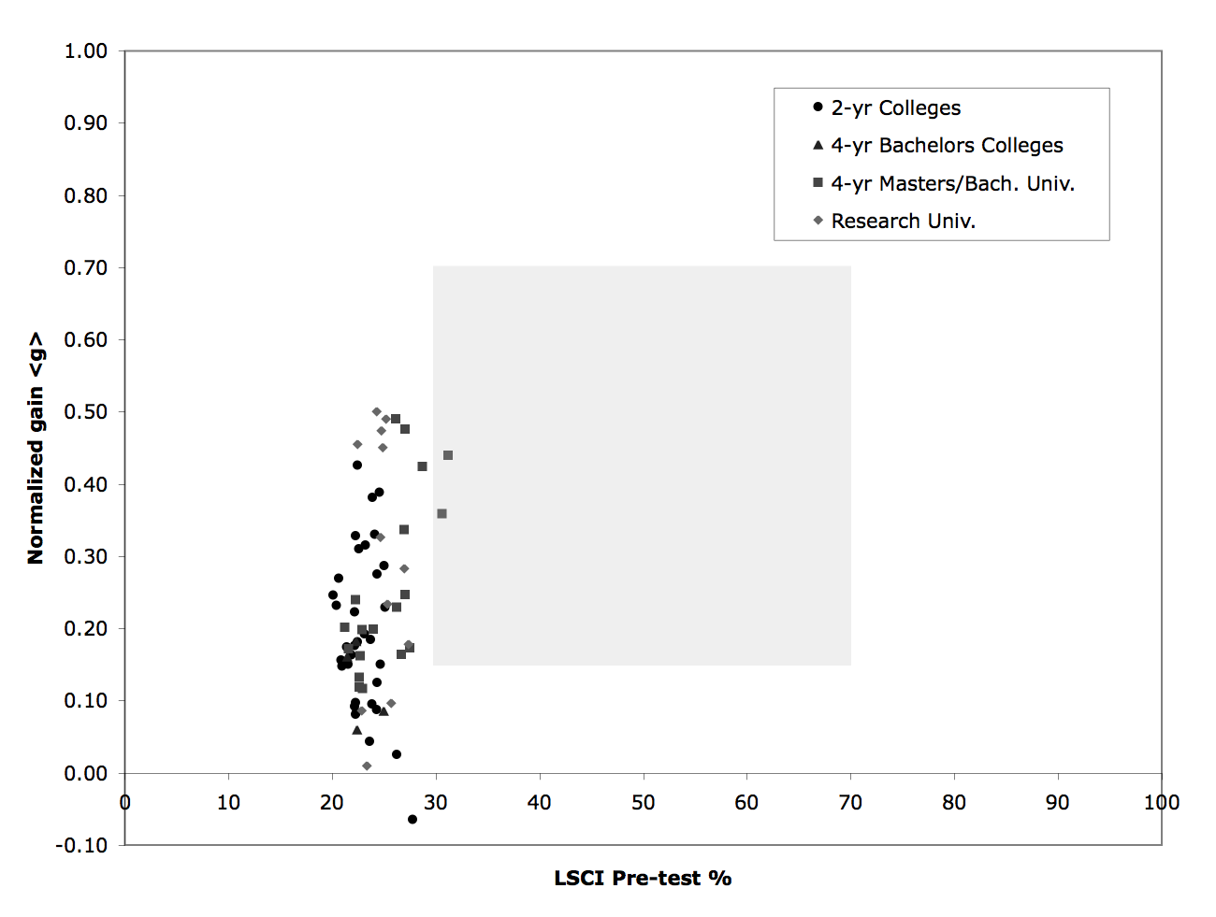

Slide 25
Instructor Surveys
To assess the level of interactivity in each classroom, we asked each instructor to fill out a survey detailing how they spent their class time
This survey was used to construct an “Interactivity Assessment Score” (IAS) based on what percentage of total class time is used for interactive activities

Slide 26
Higher IAS (>25%)
<g>avg = 0.29
Lower IAS (<25%)
<g>avg = 0.13

Slide 27
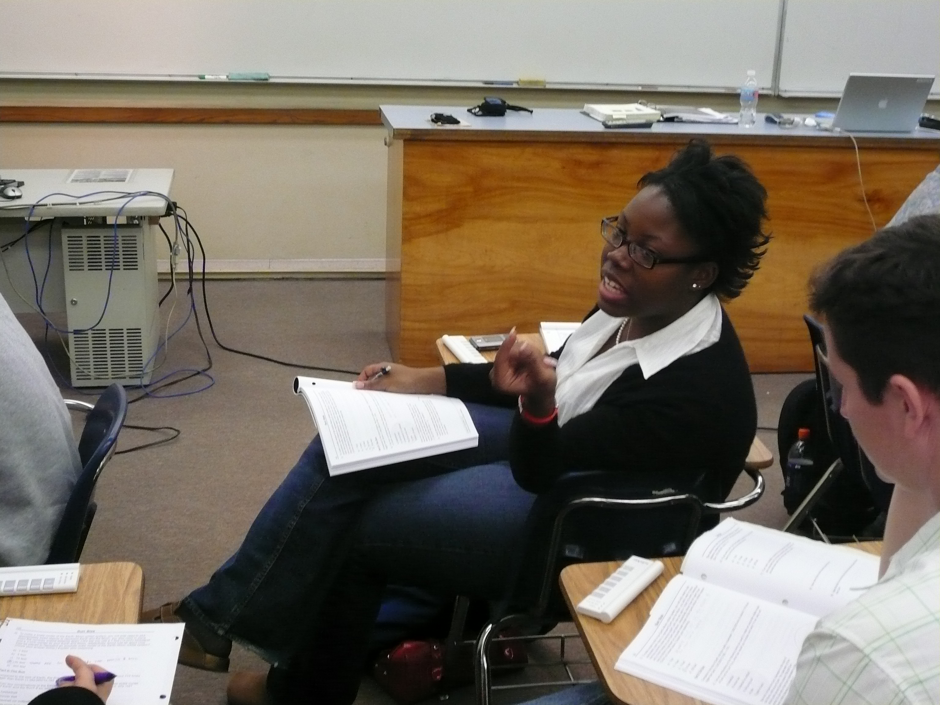

Demographic Survey
We also asked 15 demographic questions to allow us to determine how such factors as
  Gender
  Ethnicity
  English as a native language
  Parental education
  Overall GPA
  Major
  Number of prior science courses
  Level of mathematical preparation
interact with instructional context to influence student conceptual learning
This survey also gives us a snapshot of who is taking Astro 101 in the US

Slide 28
We conducted a full multivariate modeling analysis of our data
We confirm that the level of interactivity is the single most important variable in explaining the variation in gain, even after controlling for all other variables

Slide 30
The take home message Part I:
The results of our investigation reveal that the positive effects of interactive learning strategies apply equally to men and women, across ethnicities, for students with all levels of prior mathematical preparation and physical science course experience, independent of GPA, and regardless of primary language. These results powerfully illustrate that all categories of students can benefit from the effective implementation of interactive learning strategies.

Slide 31
The take home message Part II
Implementation is the most important factor to success in student learning.
More work on professional development of faculty is needed if we are to see wide spread adoption and proper implementation of research-validated instructional strategies.

Slide 32
Item Response Theory (IRT)

Slide 33
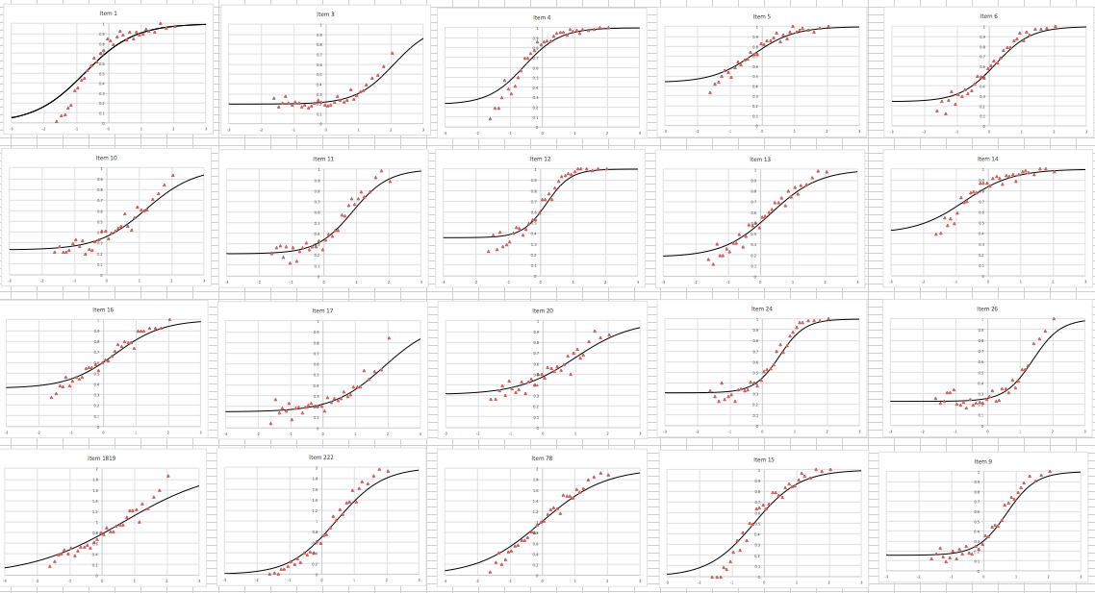

Slide 34
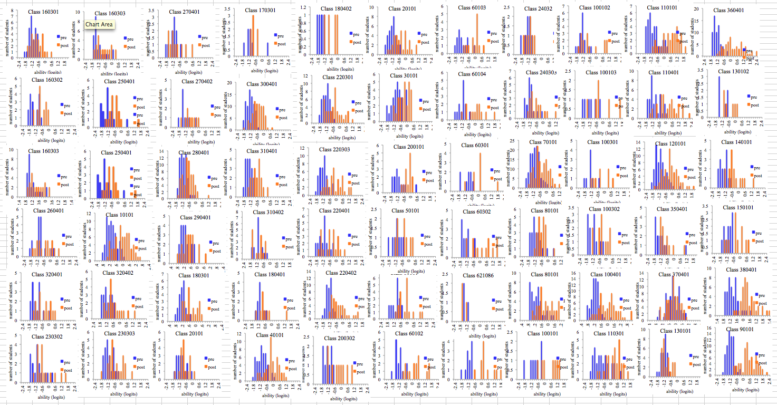

Slide 35
A
B
C
D

Slide 36
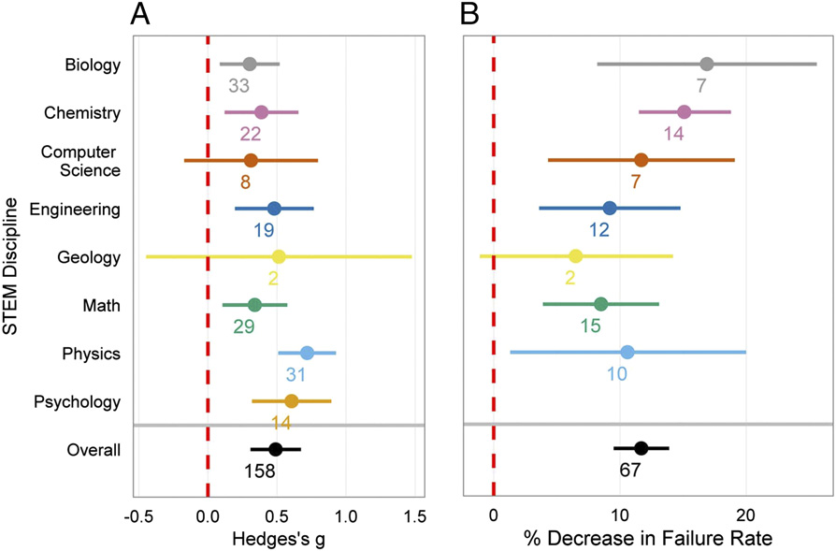
Learning Gains % Decrease in Failure Rate
Numbers indicate # of studies reviewed
traditional lecture class - mean scores
Freeman S et al. PNAS 2014;111:8410-8415

