Slide 1
TPS for Problem Solving
Dr. Edward Prather
University of Arizona
Center for Astronomy Education (CAE)
http://astronomy101.jpl.nasa.gov

Slide 3
Insights from the Univ. of Arizona AAU STEM reform effort in Physics
Reformed Class
Two 50 minute lectures per week
Focused on introducing concepts using active engagement instructional strategies and on collaborative group problem solving
Minimal derivations of equations
Each student also attends a 50 minute recitation sections per week
Led by graduate TA with assistance from undergraduate peer instructors
Students work on collaborative tutorials, which promote reasoning abilities and problem solving skills
Instructor experienced in astronomy and physics education research, but teaching PHYS 141 for the first time
Traditional Class
Three 50 minute lectures per week
Focused on introducing concepts and on instructor-led modeling of problem solving
Many derivations of equations
Instructor experienced in teaching PHYS 141 and widely regarded by faculty and students as an excellent lecturer

Slide 4
Chapter 6: Work and Kinetic Energy
θ
A constant force is applied to an object. The object has a straight-line displacement .
The work W by the force on the object is given by
SI unit of work: Joules (J)
“dot product”
aka “scalar product”
(see Section 1.10)
Force and displacement are vectors, but work is a scalar.

Slide 5
When a force (or component of a force) points in the same direction as the displacement, the work done by that force is positive (W > 0).
When a force (or component of a force) points in the opposite direction as the displacement, the work done by that force is negative (W < 0).
When a force is perpendicular to the displacement, the work done by that force is zero (W = 0).

Slide 6
In the cases below (1-5), identical particles experience the same displacement. The forces shown acting on the particles all have the same magnitude. Rank each case based on the work done on the particle, from most negative to most positive.
Case 1
Case 2
Case 3
Case 4
Case 5
1, 3, 5, 2, 4
5, 3, 4, 1, 2
5, 3, 1, 4, 2
4, 2, 5, 3, 1
None of the above.

Slide 7
When many forces act on an object, we can calculate the work done on that object by each of those forces.
The sum of all of these works is called the net work (W_{net}).
A 3.0 kg box starts from rest and slides for 2.0 m down a 30º incline. The coefficient of static friction between the box and the incline is μ_{k} = 0.1. Find W_{net}.
box
30º

Slide 8
Draw the Free Body Diagram for the Box
A 3.0 kg box starts from rest and slides for 2.0 m down a 30º incline. The coefficient of static friction between the box and the incline is μ_{k} = 0.1. Find W_{net}.
box
30º

Slide 9
Which of the following is the correct free-body diagram for the box?
A
N_{IB}
B
N_{IB}
C
N_{IB}
f_{IB}
f_{IB}
f_{IB}
W_{EB}
W_{EB}
W_{EB}
D
E
N_{IB}
N_{IB}
f_{IB}
f_{IB}
W_{EB}
W_{EB}

Slide 10
A 3.0 kg box starts from rest and slides for 2.0 m down a 30º incline. The coefficient of static friction between the box and the incline is μ_{k} = 0.1. Find W_{net}.
coordinate axes
free-body diagram
+y
N_{IB}
box
f_{IB}
+x
30º
30º
W_{EB}
Is the work done by the normal force (W_{N}) on the box positive, negative, or zero?
positive
negative
zero

Slide 11
A 3.0 kg box starts from rest and slides for 2.0 m down a 30º incline. The coefficient of static friction between the box and the incline is μ_{k} = 0.1. Find W_{net}.
coordinate axes
free-body diagram
+y
N_{IB}
box
f_{IB}
+x
30º
30º
W_{EB}
Is the work done by the friction force (W_{f}) on the box positive, negative, or zero?
positive
negative
zero

Slide 12
A 3.0 kg box starts from rest and slides for 2.0 m down a 30º incline. The coefficient of static friction between the box and the incline is μ_{k} = 0.1. Find W_{net}.
coordinate axes
free-body diagram
+y
N_{IB}
box
f_{IB}
+x
30º
30º
W_{EB}
Is the work done by the weight force (W_{W}) on the box positive, negative, or zero?
positive
negative
zero

Slide 13
A 3.0 kg box starts from rest and slides for 2.0 m down a 30º incline. The coefficient of static friction between the box and the incline is μ_{k} = 0.1. Find W_{net}.
coordinate axes
free-body diagram
+y
N_{IB}
box
f_{IB}
+x
30º
30º
W_{EB}
Work done on box by friction force:
f_{IB} is given by which of the following?

Slide 14
A 3.0 kg box starts from rest and slides for 2.0 m down a 30º incline. The coefficient of static friction between the box and the incline is μ_{k} = 0.1. Find W_{net}.
coordinate axes
free-body diagram
+y
N_{IB}
box
f_{IB}
+x
30º
30º
W_{EB}
Work done on box by friction force:
f_{IB} is given by which of the following?
μ_{k} mg cos (30º)
μ_{k} mg sin (30º)
μ_{k} mg cos (60º)
μ_{k} mg
More than one of the above.

Slide 15
A 3.0 kg box starts from rest and slides for 2.0 m down a 30º incline. The coefficient of static friction between the box and the incline is μ_{k} = 0.1. Find W_{net}.
coordinate axes
free-body diagram
+y
N_{IB}
box
f_{IB}
+x
30º
30º
W_{EB}
The work done by the weight force (W_{W}) is given by which of the following?

Slide 16
A 3.0 kg box starts from rest and slides for 2.0 m down a 30º incline. The coefficient of static friction between the box and the incline is μ_{k} = 0.1. Find W_{net}.
coordinate axes
free-body diagram
+y
N_{IB}
box
f_{IB}
+x
30º
30º
W_{EB}
The work done by the weight force (W_{W}) is given by which of the following?
mg d
mg d sin (60º)
mg d cos (30º)
mg d cos(60º)
More than one of the above.

Slide 17
A 3.0 kg box starts from rest and slides for 2.0 m down a 30º incline. The coefficient of static friction between the box and the incline is μ_{k} = 0.1. Find W_{net}.
coordinate axes
free-body diagram
+y
N_{IB}
box
f_{IB}
+x
30º
30º
W_{EB}
What is the net work (W_{net}) done on the box?

Slide 18
A 3.0 kg box starts from rest and slides for 2.0 m down a 30º incline. The coefficient of static friction between the box and the incline is μ_{k} = 0.1. Find W_{net}.
coordinate axes
free-body diagram
+y
N_{IB}
box
f_{IB}
+x
30º
30º
W_{EB}
What is the net work (W_{net}) done on the box?
34.5 J
29.4 J
24.3 J
5.1 J
None of the above.

Slide 19
A 3.0 kg box starts from rest and slides for 2.0 m down a 30º incline. The coefficient of static friction between the box and the incline is μ_{k} = 0.1. Find W_{net}.
coordinate axes
free-body diagram
+y
N_{IB}
box
f_{IB}
+x
30º
30º
W_{EB}

Slide 20
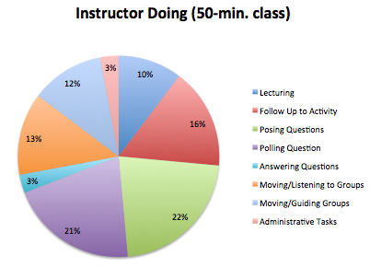
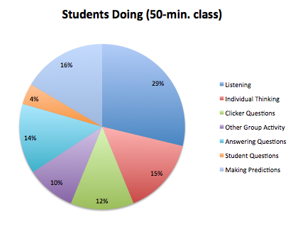
COPUS data from UA Calc-Physics Reformed Course

