Slide 1
PhET’s Future: Enhanced Teacher Resources, HTML5, and Touch!
Ariel Paul
http://phet.colorado.edu

Slide 2
PhET’s Goals for Students
See science as accessible and enjoyable
Make connections to everyday life
Achieve conceptual learning
Scientific exploration with multiple learning outcomes
Ownership of the learning experience

Slide 3
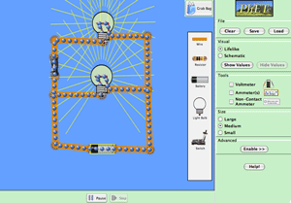
Flexibility
Core to our design philosophy
Tailor to environment and learning goals
CCK in grade school: “Make the light bulb light”
CCK in college: “Explain why the light dims when you turn the heater on”

Slide 4
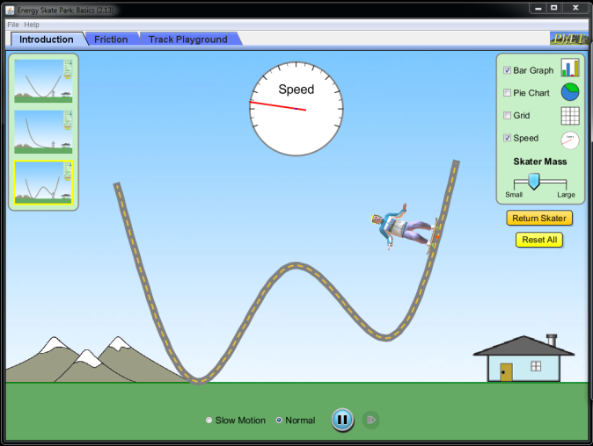
Implicit Scaffolding
Highly interactive
Guide without feeling guided
Choice of controls

Slide 5
Ideas for Using Sims
In class activity, demo, concept questions, homework, group work…
Address difficult learning goals

Slide 6
Activity Design Goals
Student-Centered:
Exploration
Discussion
Sense making
Flexible – Adapt Activity:
Prior to class
In the classroom
PhET Sim
Activity Sheet
Teacher Facilitation

Slide 7
Activity Sheet Guidelines
Begin with open play
Take advantage of sim features
Short activity sheet
Minimal wording
Scaffold – “concept tables”

Slide 8
Concept Tables
Example: Highlighting Cause/Effect Relationships
Action | What Changes? | How Does it Change?
Add a Electron | ☐ Element
 | ☐ Charge
 | ☐ Mass
Action | Gravity Force
Put star and planet close together | ☐ Increases ☐ Decreases
 | ☐ Increases ☐ Decreases
 | ☐ Increases ☐ Decreases

Slide 9
Prompting Investigation
Example Challenge Prompts:
Find all the ways to… make a complete circuit.
What is the largest… molecule you can make?
List all the essential items to…make a circuit.
What are two ways to… change the Earth’s orbit?
How can you make…the gravity force…bigger?

Slide 10
Teach with PhET
Companion Site:
Guides
“Primers”
Easier Searching
Community
Coming Late Fall

Slide 11
Enhanced Resources

Slide 12
HTML5
Increase accessibility – tablets (iPad)
Increase flexibility – assessment possibilities
Touch interfaces
First sims mid-August

Slide 13
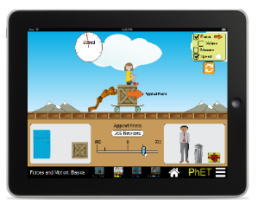
Mouse vs. Touch
New challenges: occlusion, hit areas, layout, feedback
New opportunities: UI improvements, flexibility, accessibility, multitouch, distributed learning…

Slide 14
Homescreen
Modern look, overview, pause point for teachers

Slide 15
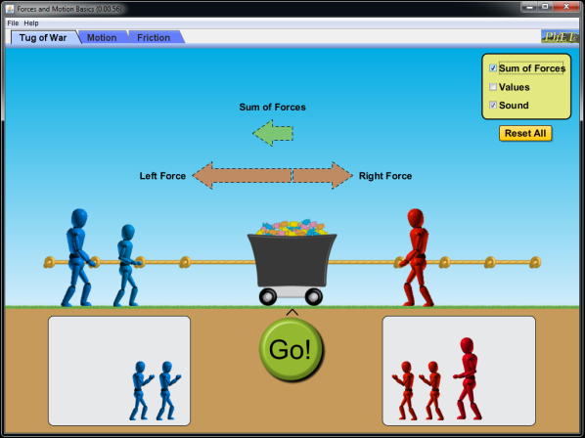
Navigation Bar
Address tab discovery – good initial results

Slide 16
Social Media

Slide 17
Conclusion
Activities designed to compliment sims
New Teach with PhET website on horizon
HTML5 – first sims mid-August
Touch interfaces (iPads)
Thanks for being a part of our community!
http://phet.colorado.edu

