Slide 1
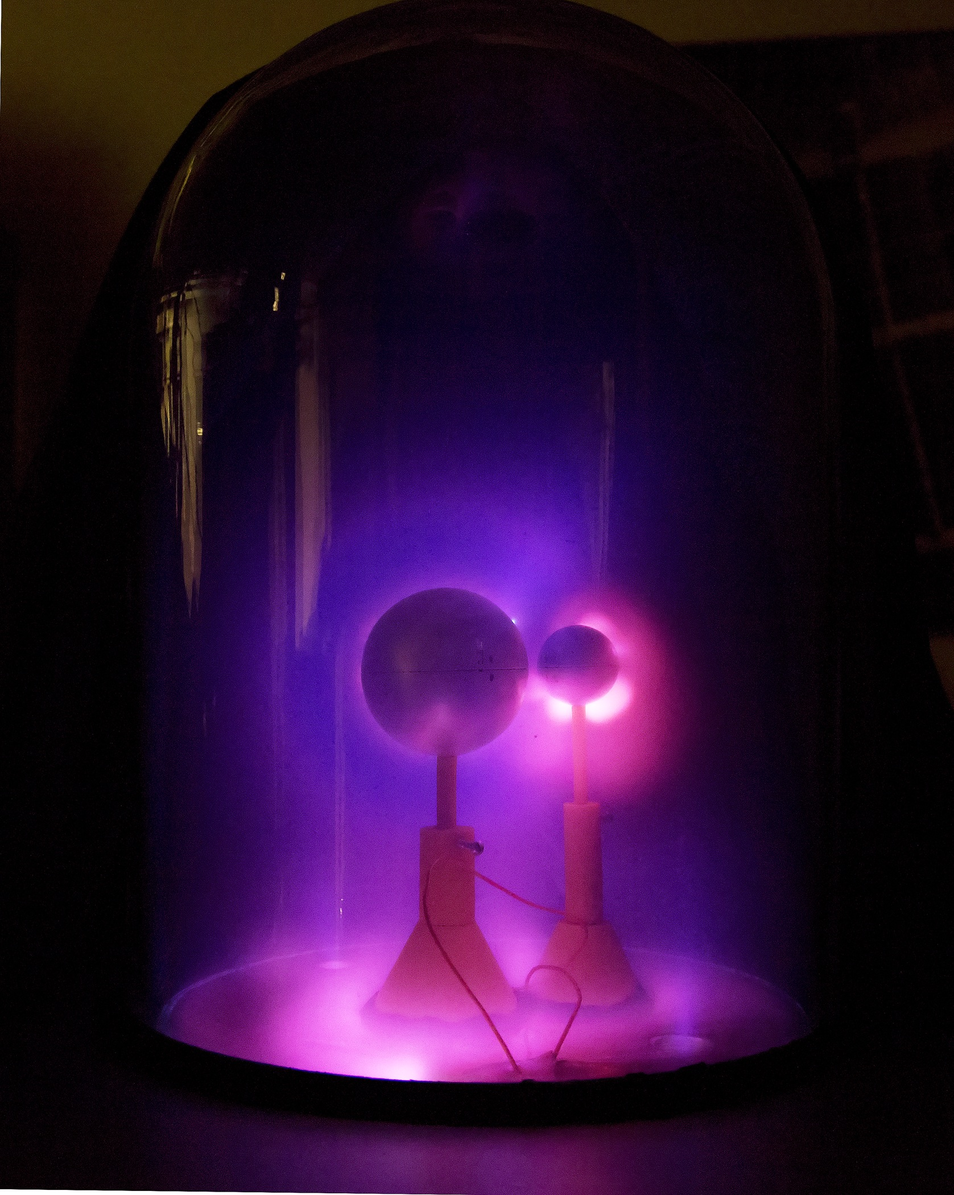
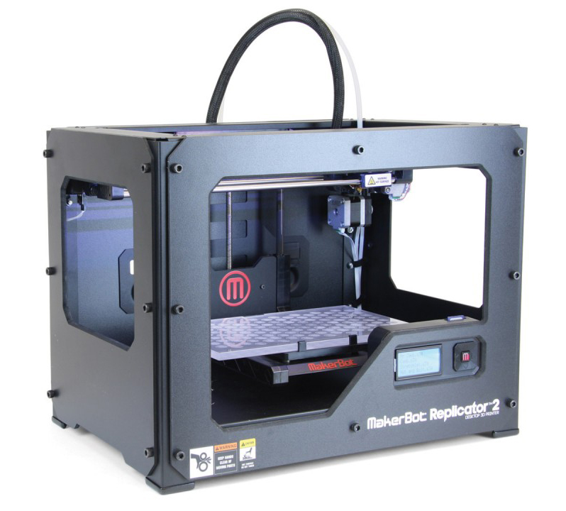
Testing Performance of 3D Printed Plastic Parts at the Princeton Plasma Physics Laboratory
Presented on behalf of:
Andrew Zwicker, Josh Bloom, Robert Albertson, Sophia Gershman and Robert Ellis
Presented by:
Arturo Dominguez

Slide 2
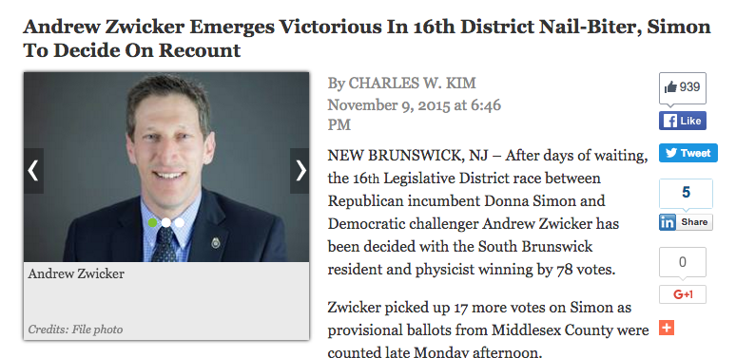
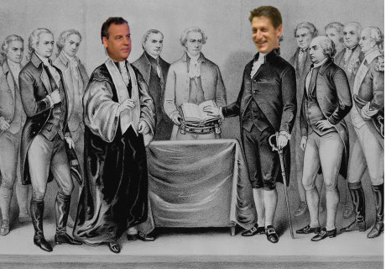
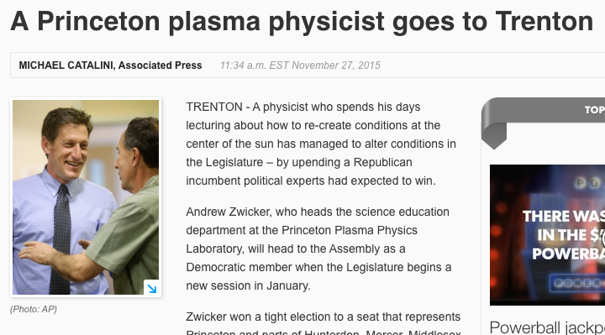
Andrew couldn’t be here due to an unforeseen swearing in ceremony
Andrew was elected NJ State Assemblyman in November and today is his swearing in ceremony
Swearing in ceremony happening now (artist’s rendition)

Slide 3


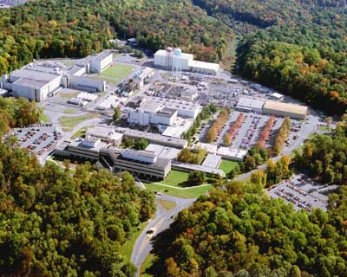
PPPL: Princeton Plasma Physics Lab
PPPL is one of 17 DoE national laboratories.
We are managed by Princeton University but have a government mandate that focuses on fusion energy research and basic plasma science.

Slide 4
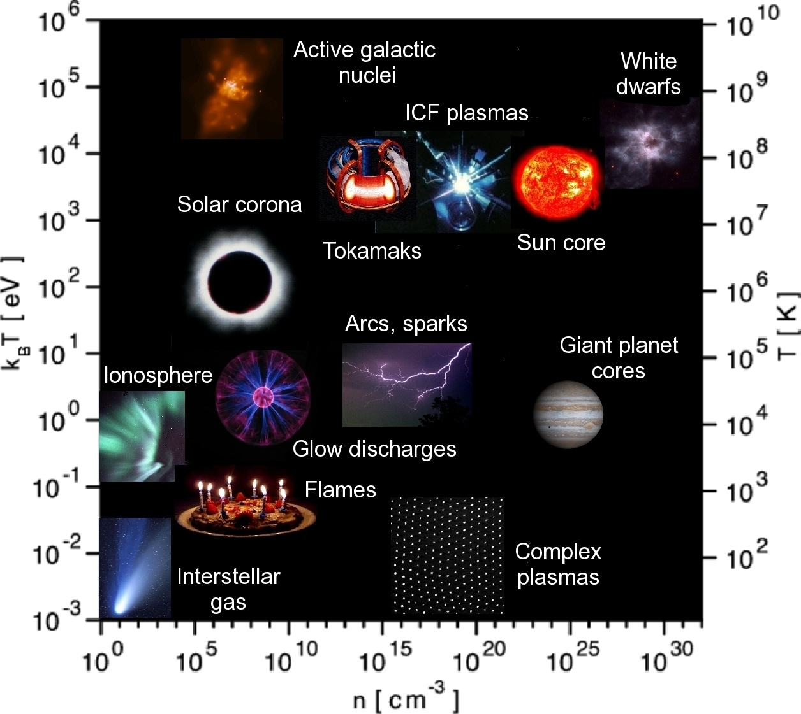
Plasma Physics is a Complex and Rich Field
Plasma is the 4th state of matter: It is qualitatively different than gas due to its collective behavior, particularly its interactions with E&M fields.
Plasmas cover a wide range of densities and temperatures This makes the field rich in scope

Slide 5
Plasma Physics is a Complex and Rich Field
Plasma is the 4th state of matter: It is qualitatively different than gas due to its collective behavior, particularly its interactions with E&M fields.
Plasmas cover a wide range of densities and temperatures This makes the field rich in scope
Room Temperature ~ 10⁻²ev
Room air density ~ 10²⁷m⁻³
All laboratory plasmas are high temperature and most are under vacuum

Slide 6
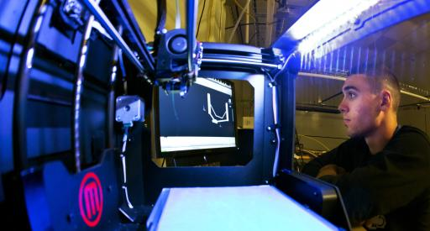
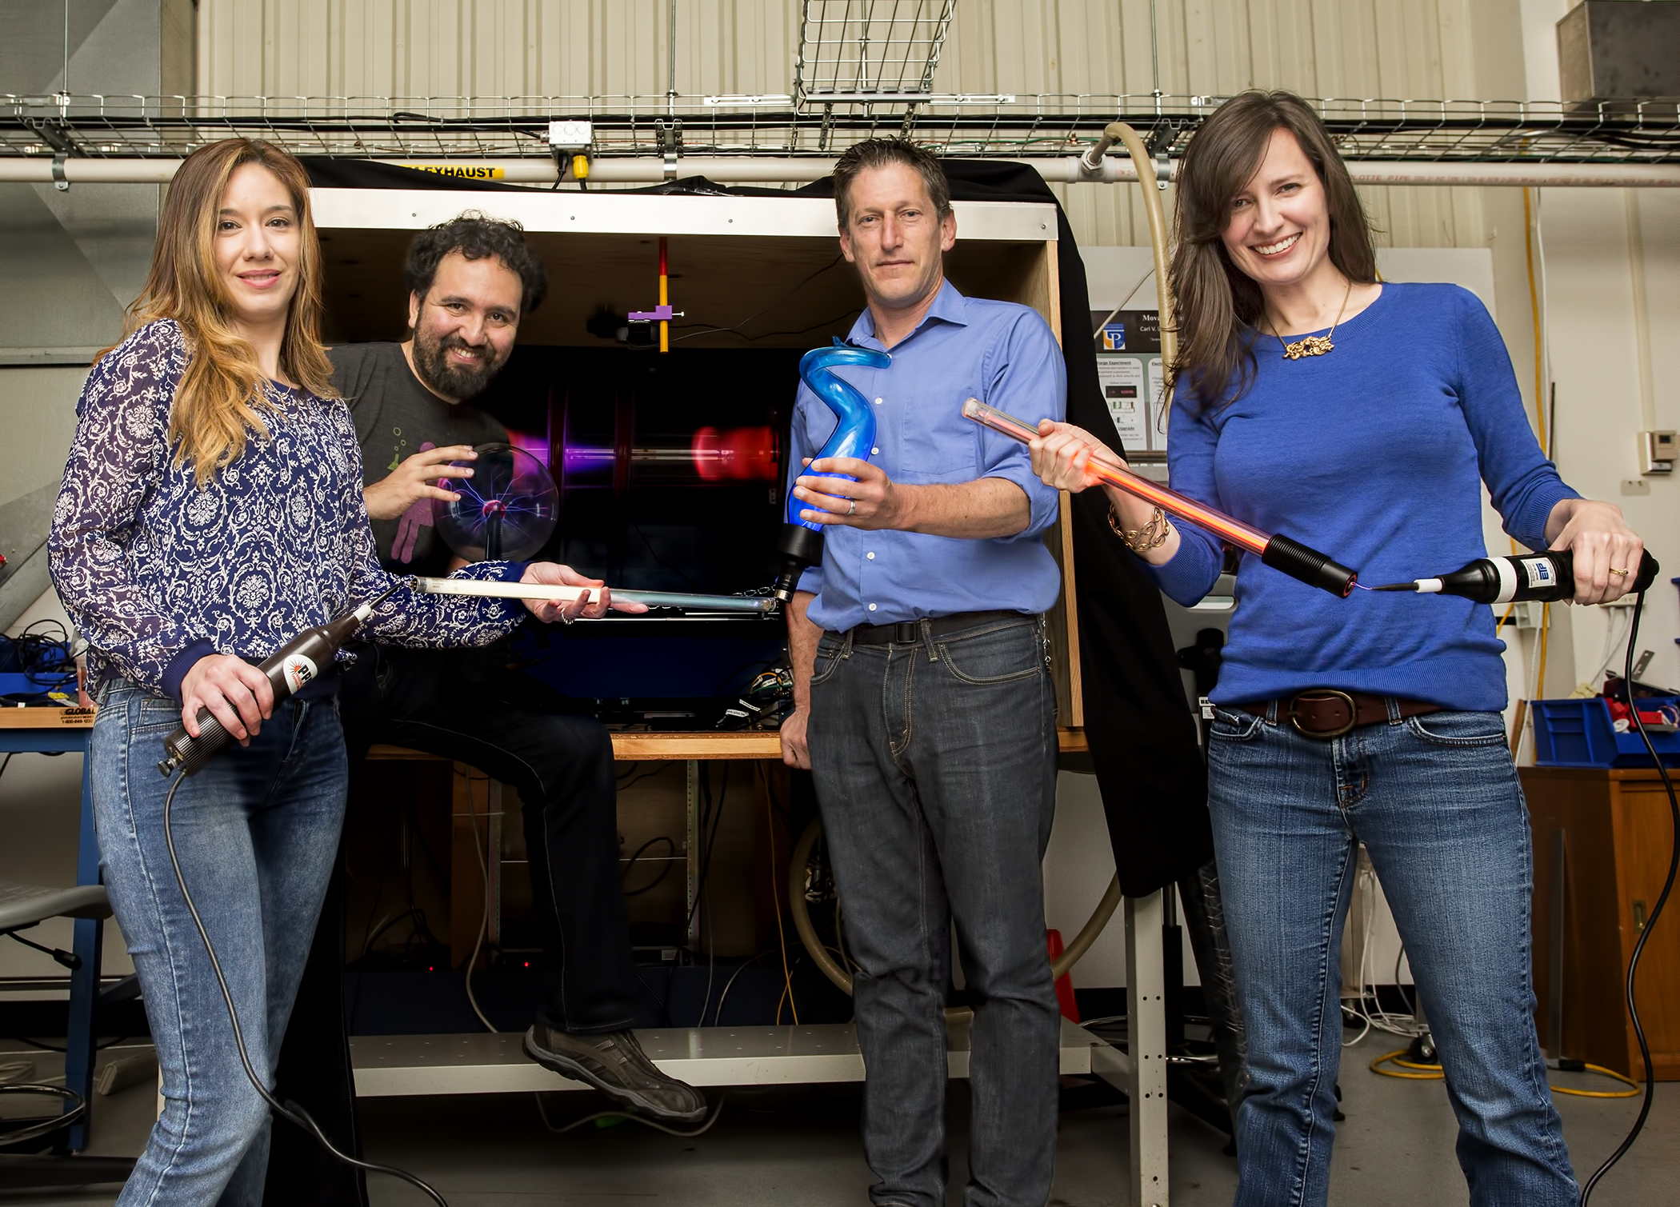
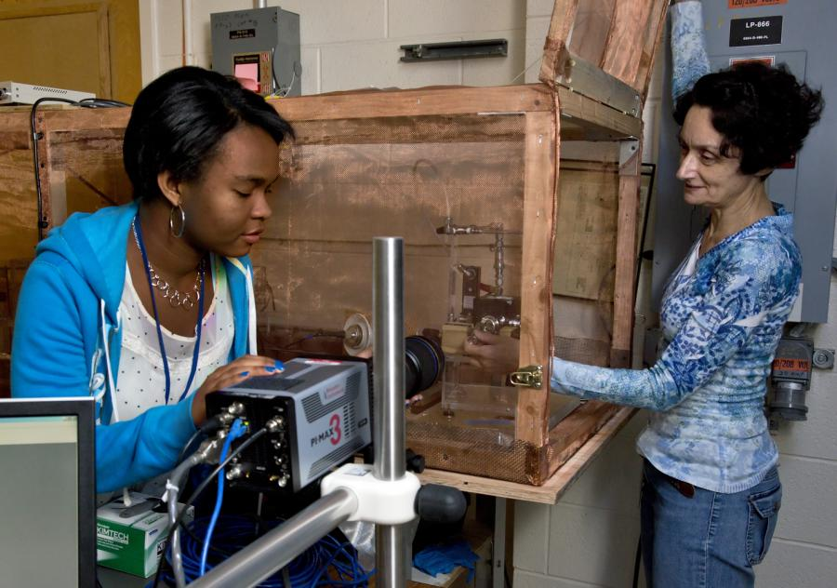
Science Education Department at PPPL
Plasma Physicists
Program Manager
Science Educator
Students
HS Physics Teacher (Collaborator)
We lead conferences, workshops and organize the HS and undergraduate internships and develop small scale laboratory experiments.
We collaborate with local HS teachers and other PPPL scientists

Slide 7
Science Education Department at PPPL
Plasma Physicists
Program Manager
Science Educator
Students
HS Physics Teacher (Collaborator)
coauthors
in
present
work
We lead conferences, workshops and organize the HS and undergraduate internships and develop small scale laboratory experiments.
We collaborate with local HS teachers and other PPPL scientists

Slide 8
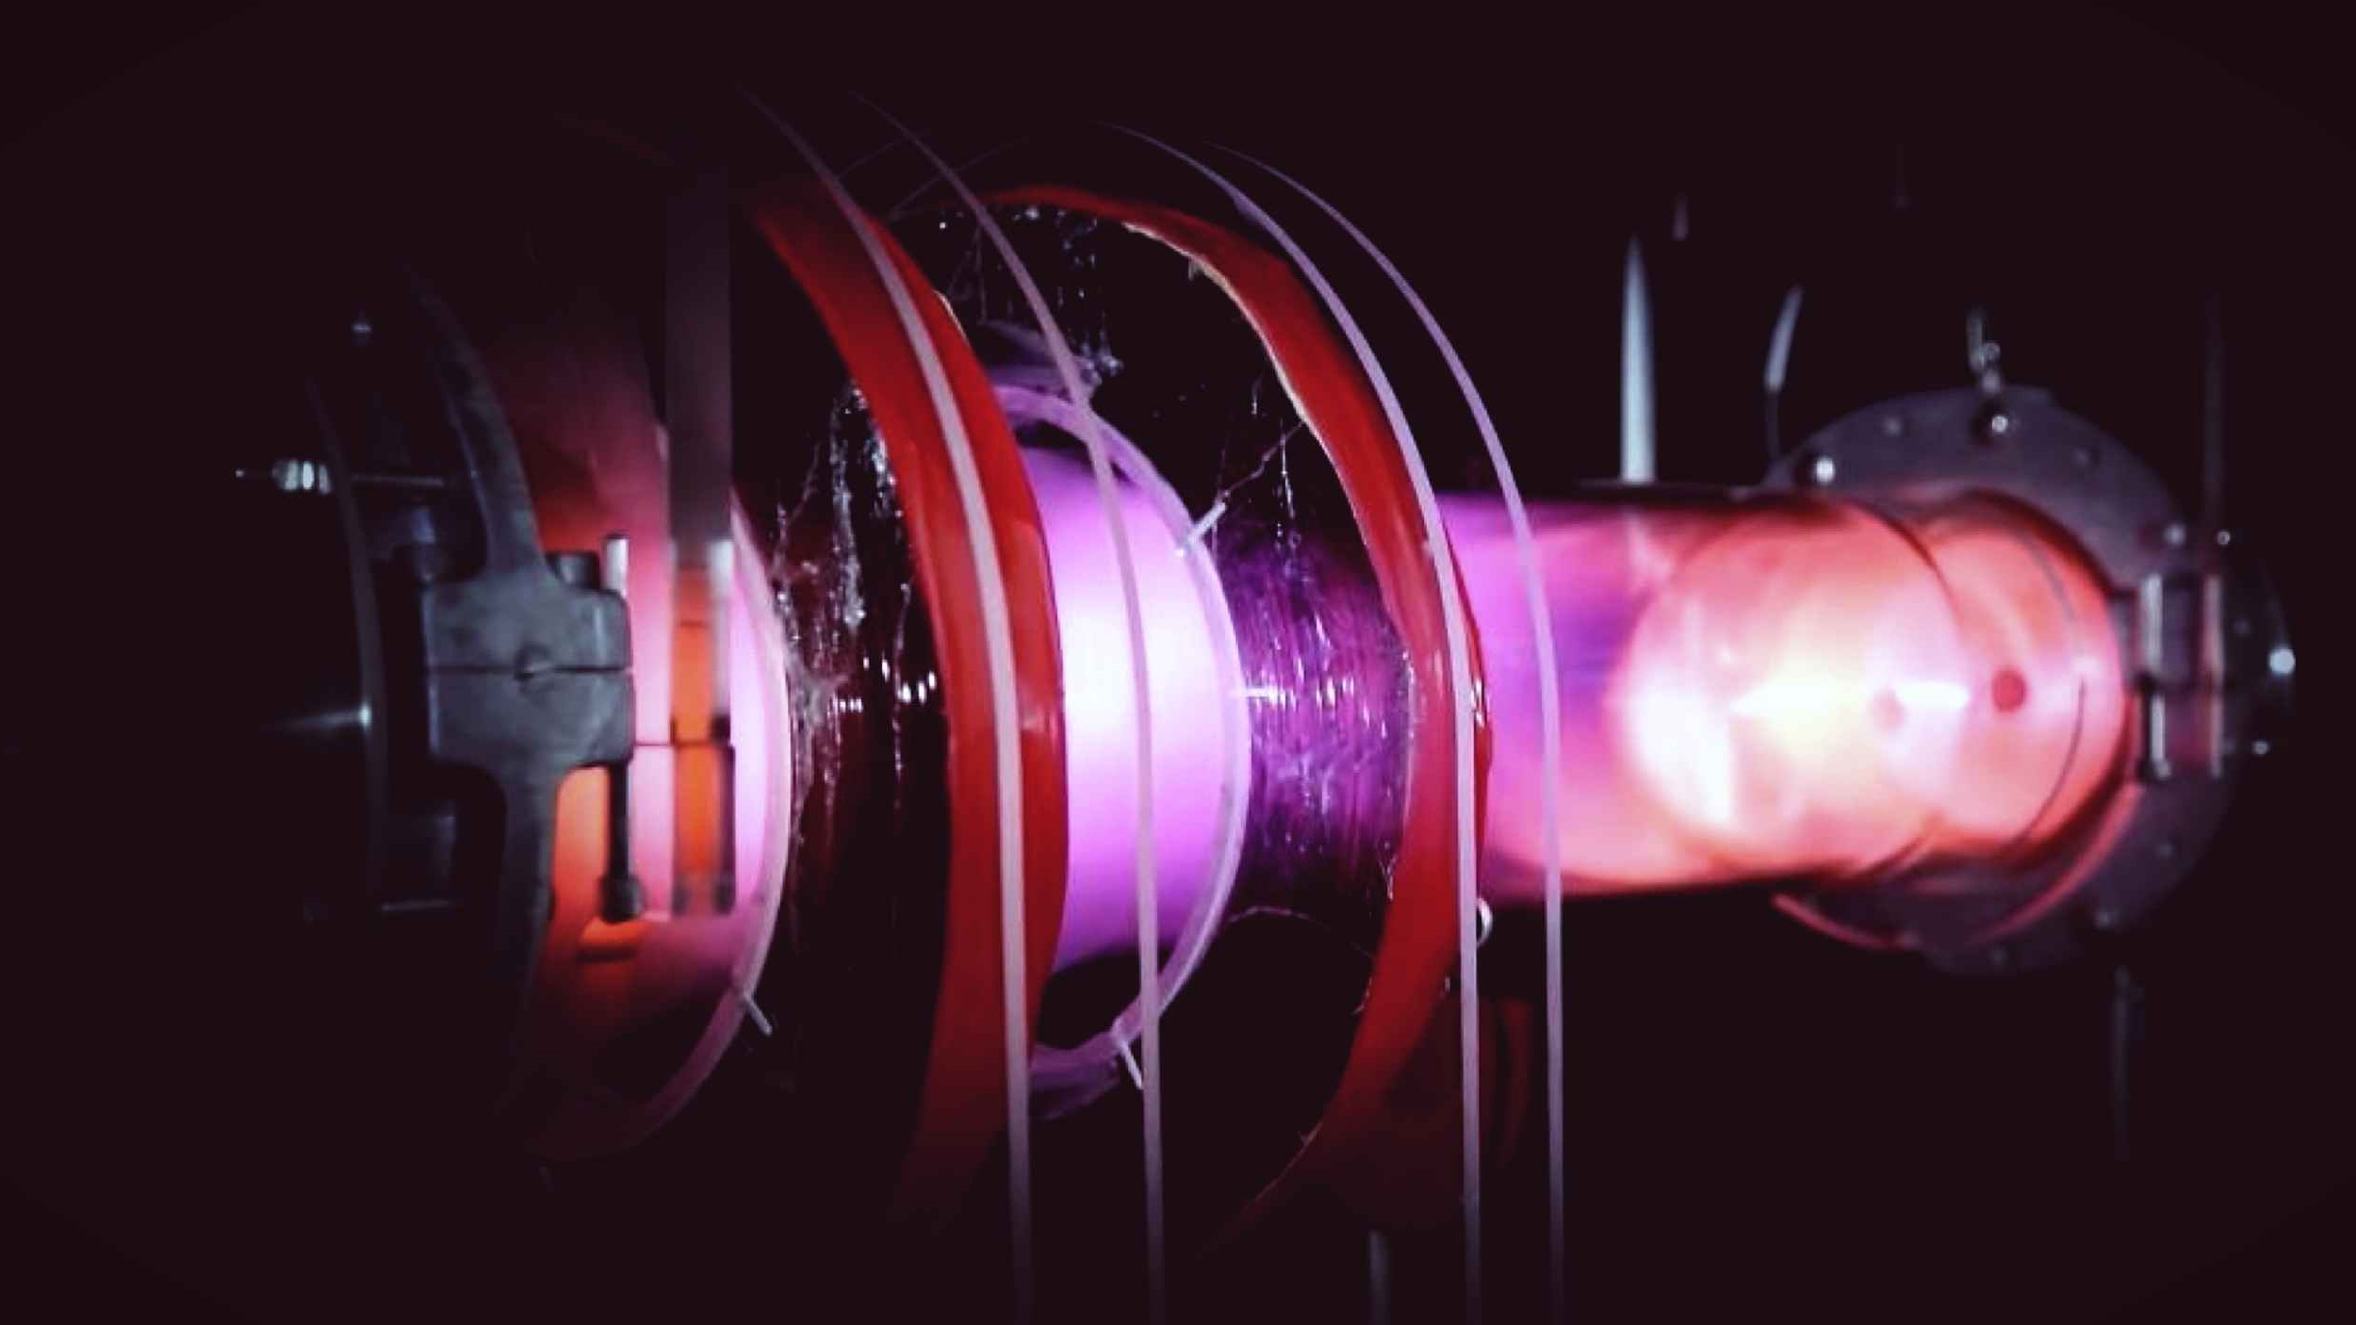
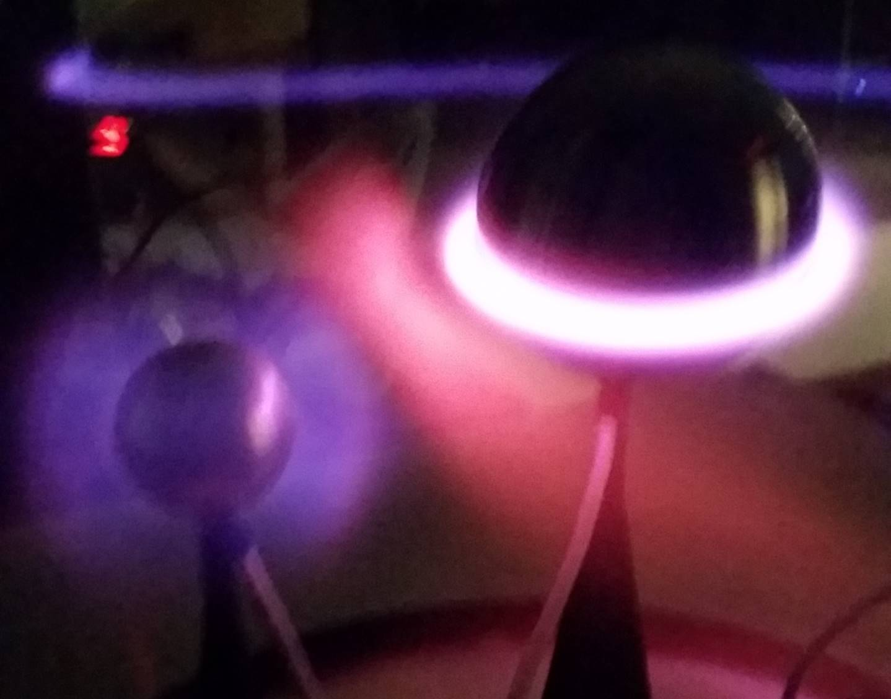
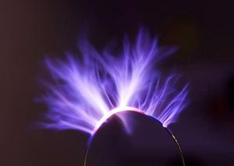
Experiments in the Science Education Laboratory
Planeterella: Simulates northern lights, ring currents, magnetosphere, etc.
RGDX (Remote Glow Discharge Experiment): Plasma experiment to explore plasma breakdown and the basics of magnetic confinement. Can be controlled remotely.
Plasma Speaker: Based on an “Eastern Voltage Research” kit, we’ve constructed several high fidelity plasma speakers using amplitude modulated high frequency (4MHz) signals and high turn ratio tesla coils.

Slide 9
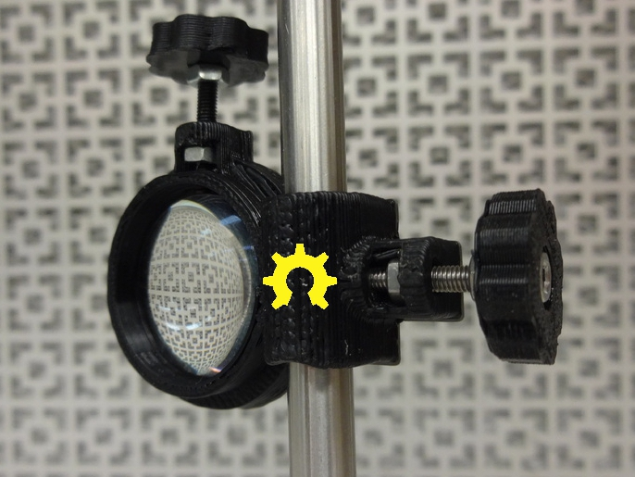
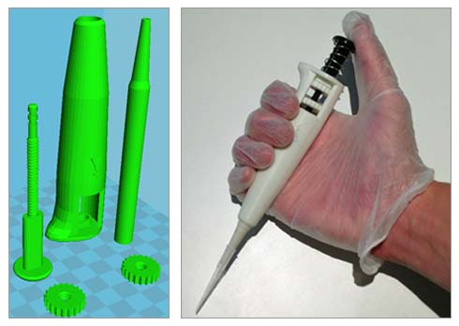
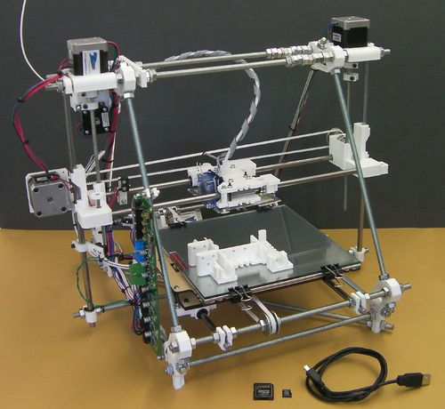

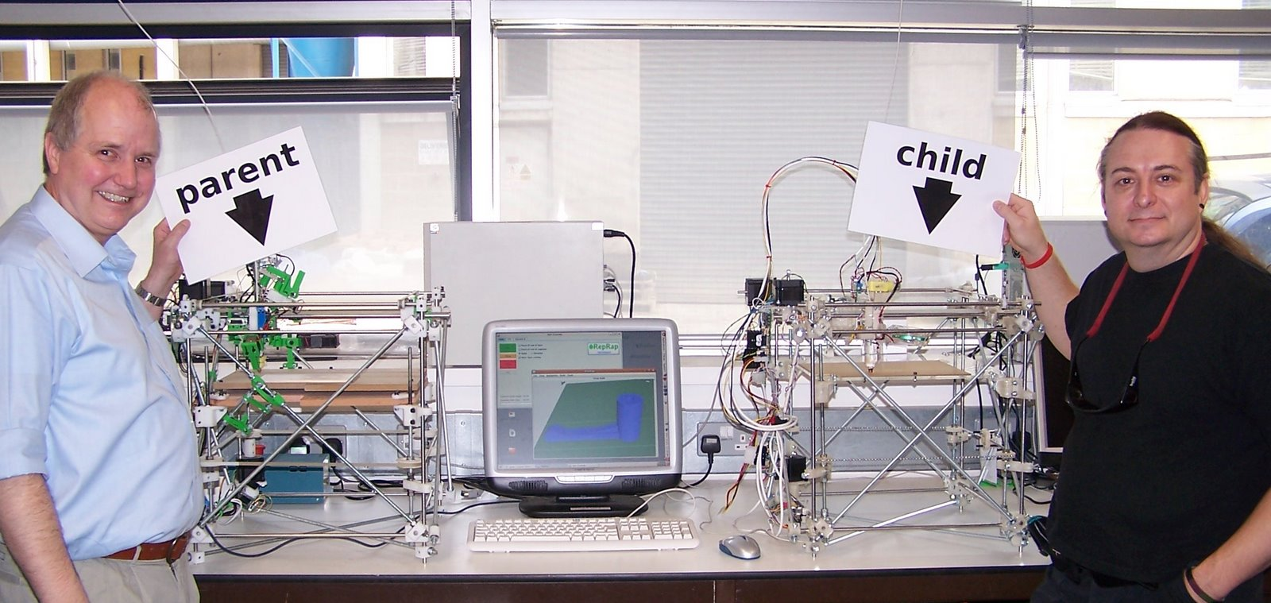
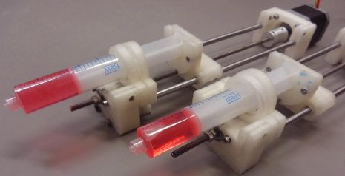
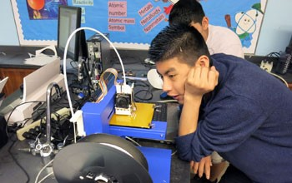
3D printing in plastic has become a ubiquitous and inexpensive lab tool
3D printing can be inexpensive if you’re patient and willing to tinker.
RepRap is a popular open-sourced, inexpensive (~$400) printer that can even fabricate a lot of its own parts.
3D printed equipment is being used in the bio-sciences, optics labs, classroom physics labs, etc.

Slide 10
Particular challenges of 3D printing in a plasma physics lab
As in other laboratory settings, we need:
-Accuracy: In order to fit and couple with other parts
-Structural integrity: Sufficient rigidity and strength for support.

Slide 11
Particular challenges of 3D printing in a plasma physics lab
As in other laboratory settings, we need:
-Accuracy: In order to fit and couple with other parts
-Structural integrity: Sufficient rigidity and strength for support.
When used in proximity to the plasma itself the parts are usually:
-Under vacuum: : Even low vacuum plasma setups are typically at 10⁻³Torr level pressures. (~0.1 Pa).
-High temperature: As shown previously, plasmas span a wide range of temperatures but all are typically well above room temperature.
-High Voltage: Laboratory plasmas are primarily generated via high voltages (~kV). Depending on the setup, the plastic parts may be subject to them.

Slide 12
All of the parts presented were printed using the Makerbot Replicator 2.
-The Makerbot Replicator 2 (MR2) was chosen due to cost, maximum size, resolution and reliability
-Max volume: 28.5cm x 15.3cm x 15.5cm
-Minimum Layer height: 100μm
-Positioning precision: 11μm horizontal , 2.5μm vertical
-Material: Polylactic acid (PLA)
-Extruder nozzle diameter: 400μm
-Extruder temp: 230°C
-Accepts: .STL, .OBJ or .THING files and slices them (g-code)
-Current price: ~$2000

Slide 13
All of the parts presented were printed using the Makerbot Replicator 2.
-The Makerbot Replicator 2 (MR2) was chosen due to cost, maximum size, resolution and reliability
-Max volume: 28.5cm x 15.3cm x 15.5cm
-Minimum Layer height: 100μm
-Positioning precision: 11μm horizontal , 2.5μm vertical
-Material: Polylactic acid (PLA)
-Extruder nozzle diameter: 400μm
-Extruder temp: 230°C
-Accepts: .STL, .OBJ or .THING files and slices them (g-code)
-Current price: ~$2000

Slide 14
All of the parts presented were printed using the Makerbot Replicator 2.
-The Makerbot Replicator 2 (MR2) was chosen due to cost, maximum size, resolution and reliability
-Max volume: 28.5cm x 15.3cm x 15.5cm
-Minimum Layer height: 100μm
-Positioning precision: 11μm horizontal , 2.5μm vertical
-Material: Polylactic acid (PLA)
-Extruder nozzle diameter: 400μm
-Extruder temp: 230°C
-Accepts: .STL, .OBJ or .THING files and slices them (g-code)
-Current price: ~$2000

Slide 15
All of the parts presented were printed using the Makerbot Replicator 2.
-The Makerbot Replicator 2 (MR2) was chosen due to cost, maximum size, resolution and reliability
-Max volume: 28.5cm x 15.3cm x 15.5cm
-Minimum Layer height: 100μm
-Positioning precision: 11μm horizontal , 2.5μm vertical
-Material: Polylactic acid (PLA)
-Extruder nozzle diameter: 400μm
-Extruder temp: 230°C
-Accepts: .STL, .OBJ or .THING files and slices them (g-code)
-Current price: ~$2000

Slide 16
Particular challenges of 3D printing in a plasma physics lab
As in other laboratory settings, we need:
-Accuracy: In order to fit and couple with other parts
-Structural integrity: Sufficient rigidity and strength for support.
When used in proximity to the plasma itself the parts are usually:
-Under vacuum: : Even low vacuum plasma setups are typically at 10⁻³Torr level pressures. (~0.1 Pa).
-High temperature: As shown previously, plasmas span a wide range of temperatures but all are typically well above room temperature.
-High Voltage: Laboratory plasmas are primarily generated via high voltages (~kV). Depending on the setup, the plastic parts may be subject to them.

Slide 17
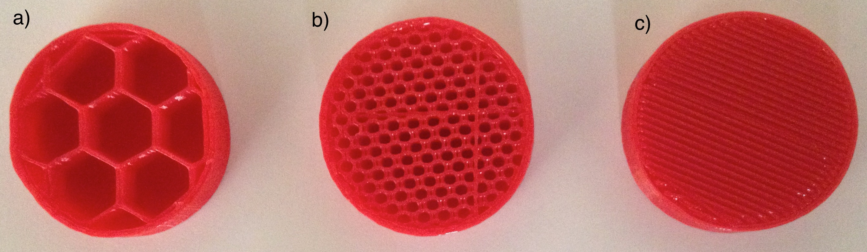
Accuracy of 3D printed objects
The user has a variety of “knobs”:
1) Resolution settings (layer thickness):
Low: 300μm
Medium: 200μm
High: 100μm
Medium Resolution (200 μm layer thickness)
Two outer shells
2) Number of shells or outer layers printed.
3) Infill: percentage of the solid filled:
10% - 100%.
10% infill
50% infill
100% infill

Slide 18
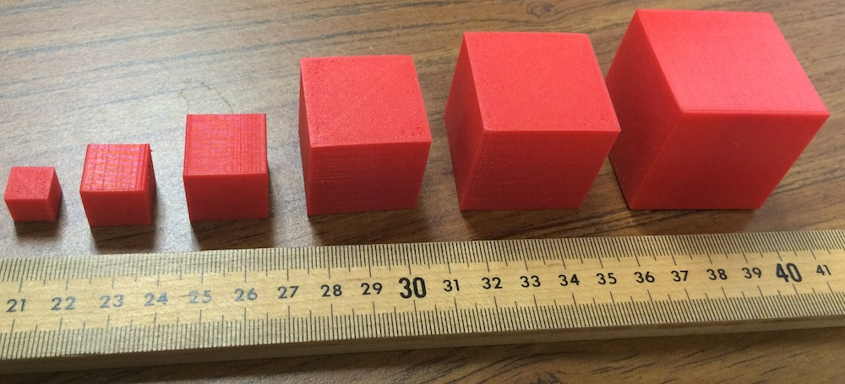
Accuracy of 3D printed objects
The user has a variety of “knobs”:
1) Resolution settings (layer thickness):
Low: 300μm
Medium: 200μm
High: 100μm
2) Number of shells or outer layers printed.
3) Infill: percentage of the solid filled:
10% - 100%.
Cubes were printed ranging in size from 1cm-4cm per side at medium resolution, 100% infill.
Errors were of order 50μm in all dimensions for all sizes.
We found this accuracy suitable for our projects but for high precision work it may not suffice

Slide 19
Particular challenges of 3D printing in a plasma physics lab
As in other laboratory settings, we need:
-Accuracy: In order to fit and couple with other parts
-Structural integrity: Sufficient rigidity and strength for support.
When used in proximity to the plasma itself the parts are usually:
-Under vacuum: : Even low vacuum plasma setups are typically at 10⁻³Torr level pressures. (~0.1 Pa).
-High temperature: As shown previously, plasmas span a wide range of temperatures but all are typically well above room temperature.
-High Voltage: Laboratory plasmas are primarily generated via high voltages (~kV). Depending on the setup, the plastic parts may be subject to them.

Slide 20
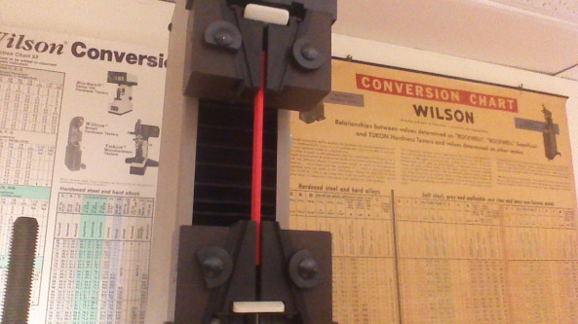
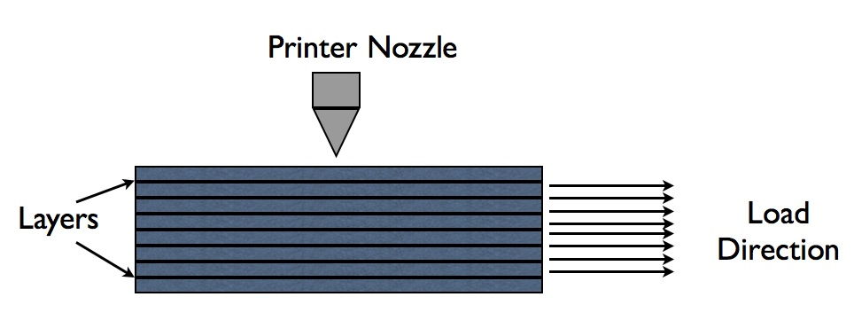
Strength experiments conducted
-Strength of 3D printed parts is essential to their usability as support structures.
-In this work we measured tensile strength of PLA pieces.
-Bars were tested using a Tines Olsen Model 1000 Universal Testing Machine until failure of the parts
-Bar sizes: 0.125in x 0.5in x 6in
-Max applied load was 1000lbs
-Load was applied along the direction of the layers

Slide 21
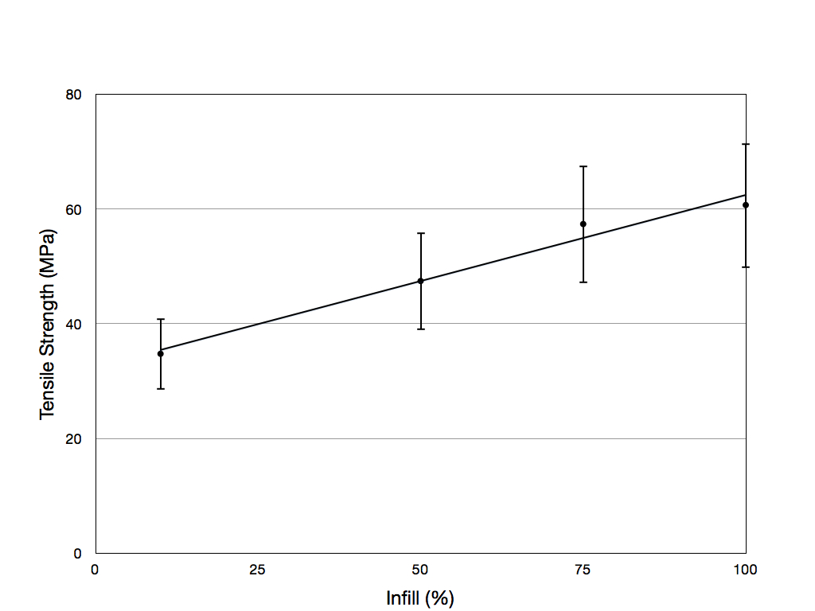
Results of strength experiments
-Pieces were printed at 10%, 50%, 75% and 100% infill
-Pieces failed with no deformation of the samples (brittle failures)
-Tensile strength of 60.6MPa for 100% infill is comparable to results from previous studies[1] of 56.6MPa. 10% infill tensile strengths averaged at 34.7MPa.
[1] BM Tymrak, et al, Materials & Design, 58, pp.242-246 (2014)

Slide 22
Particular challenges of 3D printing in a plasma physics lab
As in other laboratory settings, we need:
-Accuracy: In order to fit and couple with other parts
-Structural integrity: Sufficient rigidity and strength for support.
When used in proximity to the plasma itself the parts are usually:
-Under vacuum: : Even low vacuum plasma setups are typically at 10⁻³Torr level pressures. (~0.1 Pa).
-High temperature: As shown previously, plasmas span a wide range of temperatures but all are typically well above room temperature.
-High Voltage: Laboratory plasmas are primarily generated via high voltages (~kV). Depending on the setup, the plastic parts may be subject to them.

Slide 23
Room temperature vacuum experiment
-A variety of print shapes with different infills were tested for vacuum compatibility
-We used a vacuum-sealed oven connected to a residual gas analyzer (RGA) and a turbo molecular pump that lowered the oven pressure to ~10⁻⁶Torr (~10⁻⁴Pa).
20C
Turbo pump
(pressure range ~10⁻⁶Torr~)
Vacuum-sealed oven
Residual gas analyzer

Slide 24
Room temperature vacuum experiment
-A variety of print shapes with different infills were tested for vacuum compatibility
-We used a vacuum-sealed oven connected to a residual gas analyzer (RGA) and a turbo molecular pump that lowered the oven pressure to ~10⁻⁶Torr (~10⁻⁴Pa).
-When the pieces were inserted and the oven was kept at room temperature (20°C), there was
-No increase in background RGA signal
-No increase in pressure
20C
Turbo pump
(pressure range ~10⁻⁶Torr~)
Vacuum-sealed oven
Residual gas analyzer

Slide 25
Particular challenges of 3D printing in a plasma physics lab
As in other laboratory settings, we need:
-Accuracy: In order to fit and couple with other parts
-Structural integrity: Sufficient rigidity and strength for support.
When used in proximity to the plasma itself the parts are usually:
-Under vacuum: : Even low vacuum plasma setups are typically at 10⁻³Torr level pressures. (~0.1 Pa).
-High temperature: As shown previously, plasmas span a wide range of temperatures but all are typically well above room temperature.
-High Voltage: Laboratory plasmas are primarily generated via high voltages (~kV). Depending on the setup, the plastic parts may be subject to them.

Slide 26
High temperature vacuum experiment
-We raised the oven temperature while monitoring the RGA signals and pressure.
-At ~75°C, hydrocarbon signals were observed (AMU>39)
-Not surprisingly, this is lower than both the extruder temperature (230°C) and the melting temperature of PLA (~170°C).
75C
Turbo pump
(pressure range ~10⁻⁶Torr~)
Vacuum-sealed oven
Residual gas analyzer

Slide 27
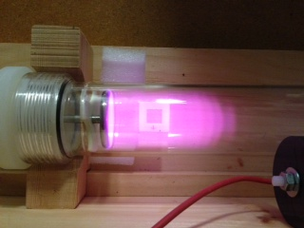
PLA pieces immersed in plasma
To further test the vacuum/high temperature feasibility of PLA parts, a printed piece was placed inside an Argon DC discharge plasma held at 500V DC voltage, 10mA current and 100mTorr pressure.
100mTorr
pump
500V 10mA

Slide 28
PLA pieces immersed in plasma
To further test the vacuum/high temperature feasibility of PLA parts, a printed piece was placed inside an Argon DC discharge plasma held at 500V DC voltage, 10mA current and 100mTorr pressure.
-After 5 hours of operation, there was no significant change in external parameters (voltage, current and pressure) and the piece had no visible damage.
100mTorr
pump
500V 10mA

Slide 29
Particular challenges of 3D printing in a plasma physics lab
As in other laboratory settings, we need:
-Accuracy: In order to fit and couple with other parts
-Structural integrity: Sufficient rigidity and strength for support.
When used in proximity to the plasma itself the parts are usually:
-Under vacuum: : Even low vacuum plasma setups are typically at 10⁻³Torr level pressures. (~0.1 Pa).
-High temperature: As shown previously, plasmas span a wide range of temperatures but all are typically well above room temperature.
-High Voltage: Laboratory plasmas are primarily generated via high voltages (~kV). Depending on the setup, the plastic parts may be subject to them.

Slide 30
Dielectric Barrier Setup
-One common use of dielectric materials in a plasma lab is the development on Dielectric Barrier Discharges (DBD).
-DBDs occur when a high frequency voltage is applied to electrodes separated by dielectrics (or dielectrics + air).
-Used for ozone generation, medical and water treatment techniques among other uses.
-3D printed dielectrics give flexibility of shape and position of electrodes and DBDs
-Different infills were tested and the DBDs were observed while measuring the current.
15kV
75-300kHz
5mm gap

Slide 31
Dielectric Barrier Setup
-One common use of dielectric materials in a plasma lab is the development on Dielectric Barrier Discharges (DBD).
-DBDs occur when a high frequency voltage is applied to electrodes separated by dielectrics (or dielectrics + air).
-Used for ozone generation, medical and water treatment techniques among other uses.
-3D printed dielectrics give flexibility of shape and position of electrodes and DBDs
-Different infills were tested and the DBDs were observed while measuring the current.
-At high infill values (100%) there were MANY filaments carrying LOW current each. At low infill values (10%) there were FEW filaments carrying HIGH current each (sometimes resulting in arcing)
15kV
75-300kHz
5mm gap

Slide 32
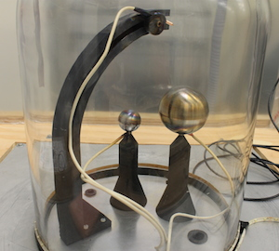
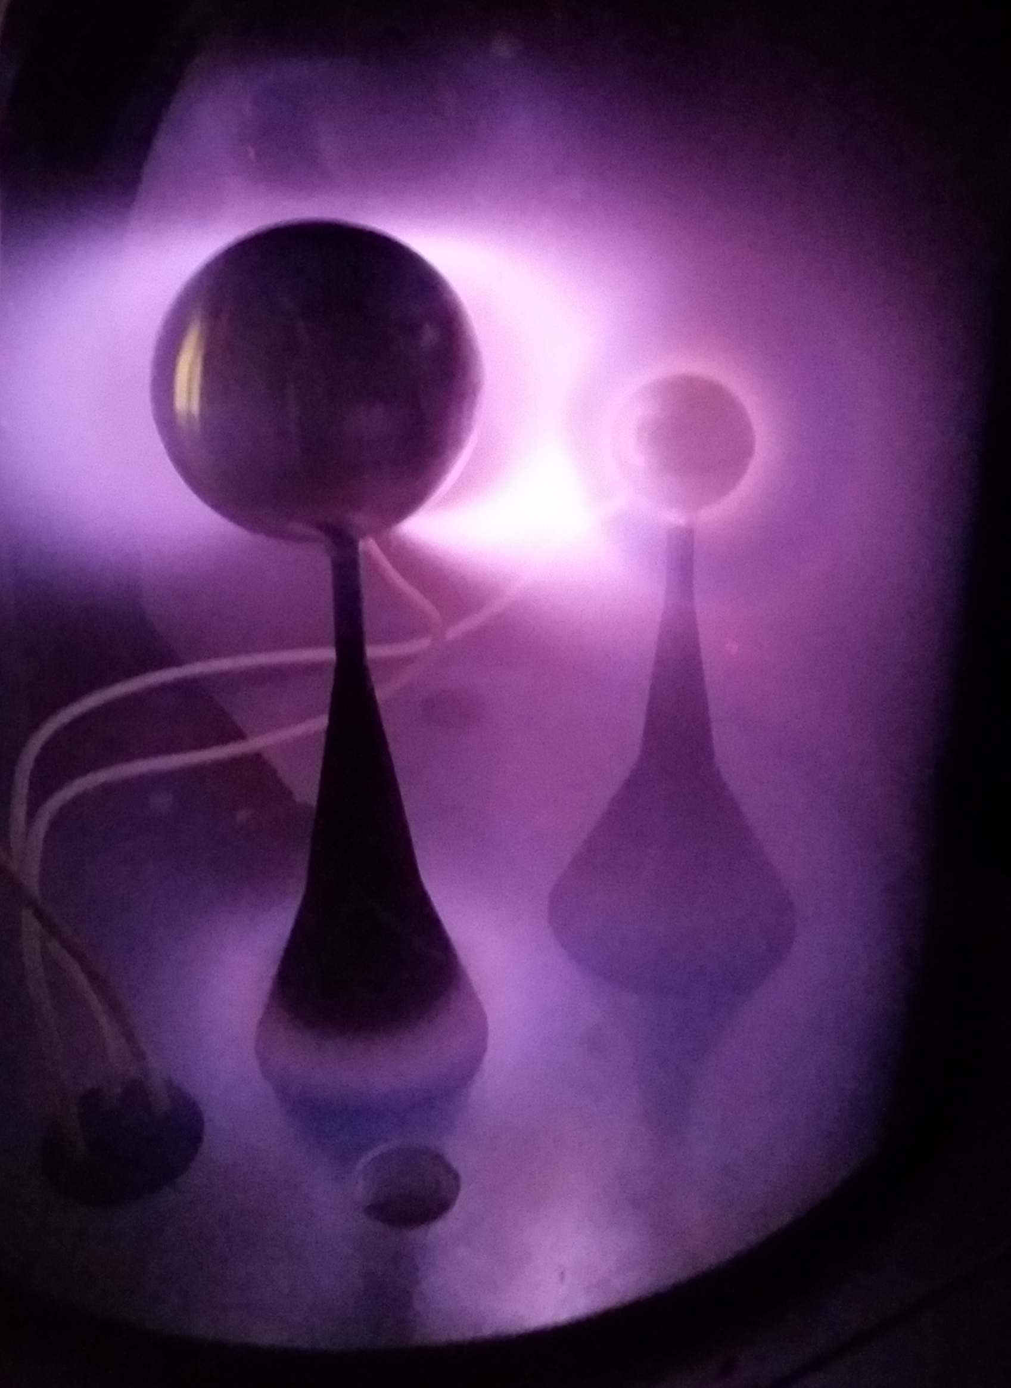
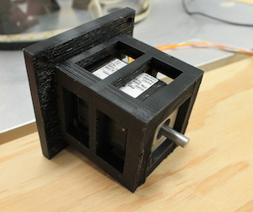
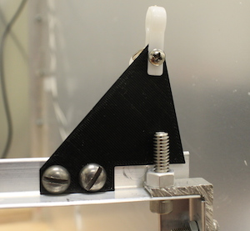
3D printed components in lab (Planeterella)
-For the Planeterella experiment, we use 3D printed structures within the vacuum to support the electrodes. They are constantly in close proximity to the plasma.
-Outside the chamber, 3D printed components are used mainly for mechanical supports (e.g. a custom enclosure for a stepper motor that has open air inlets).

Slide 33
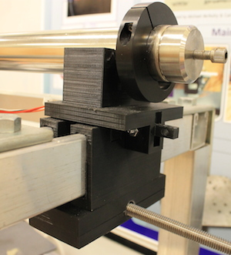
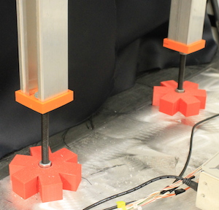
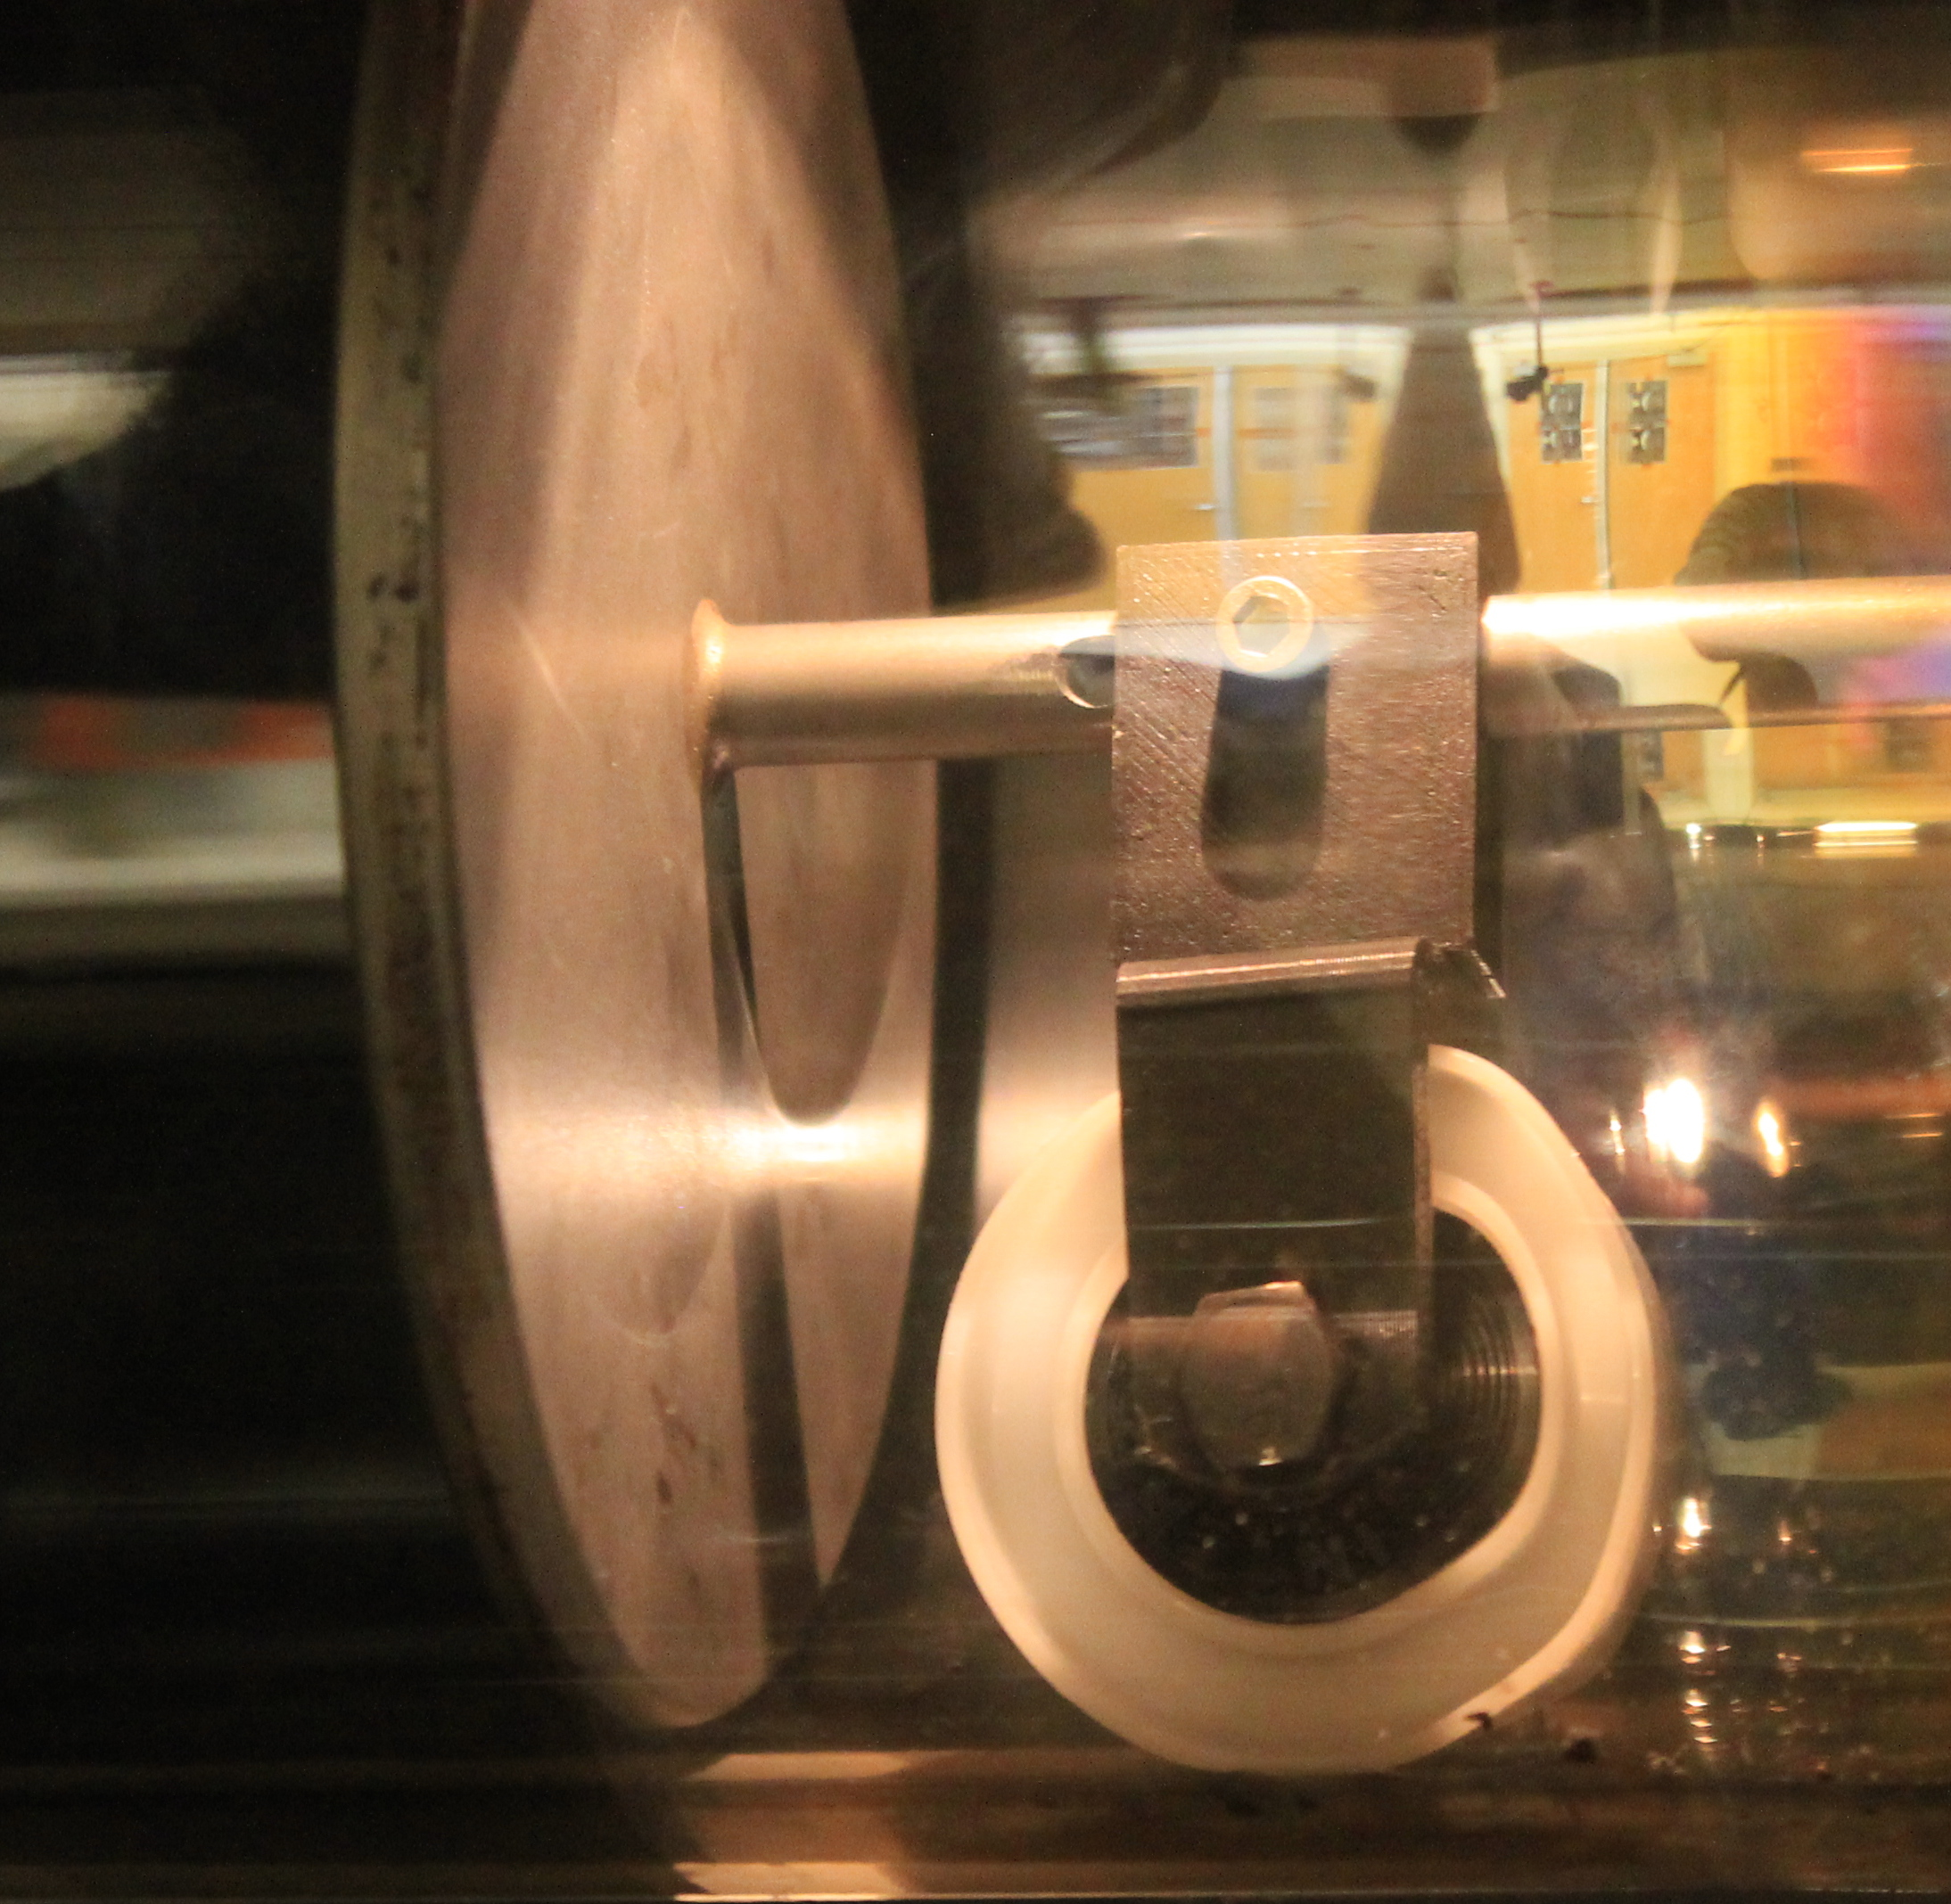
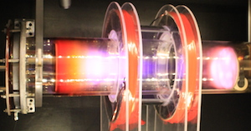
3D Printed Parts for the Remote Glow Discharge Experiment (RGDX)
-We use many 3D printed parts for the RGDX.
-Many as external support structures were custom made and printed in the lab
-Inside the vessel, a wheel is used to support one of the electrodes. The wheel support was 3D printed.

Slide 34
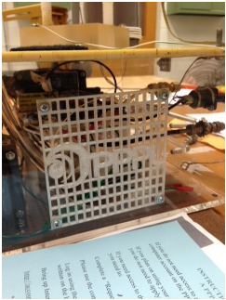
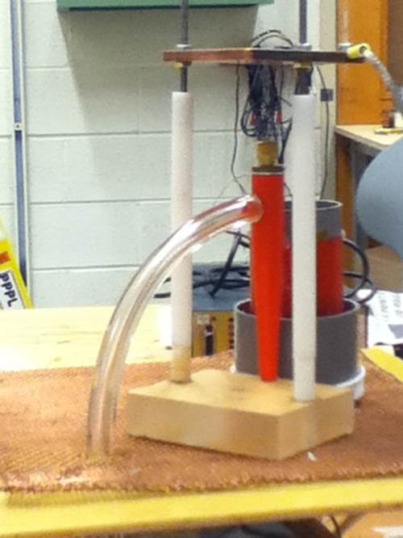
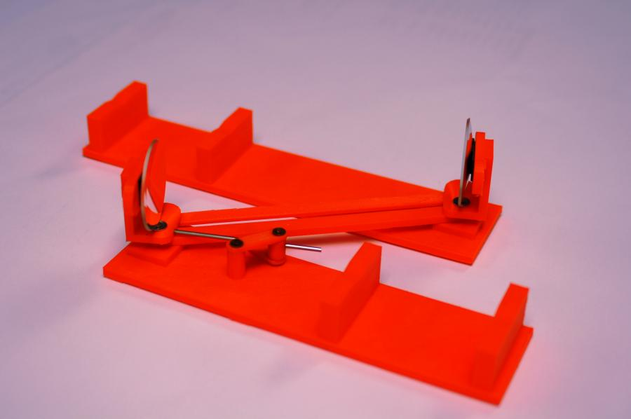
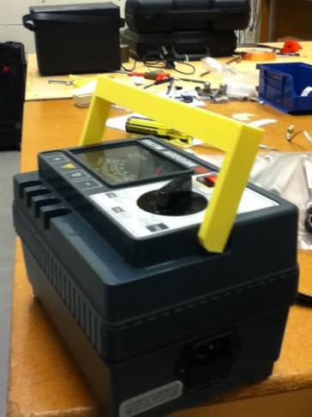
…A few more examples of 3D printed components in the lab
Custom fan protector
Telescopic mirror mechanism: A working small scale model. The actual mechanism will be used in the next generation fusion reactors.
Plasma speaker support: Variable support structure for the plasma speaker
Replacement handle

Slide 35
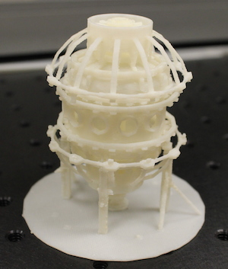
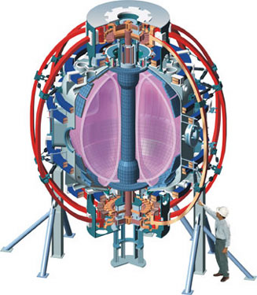
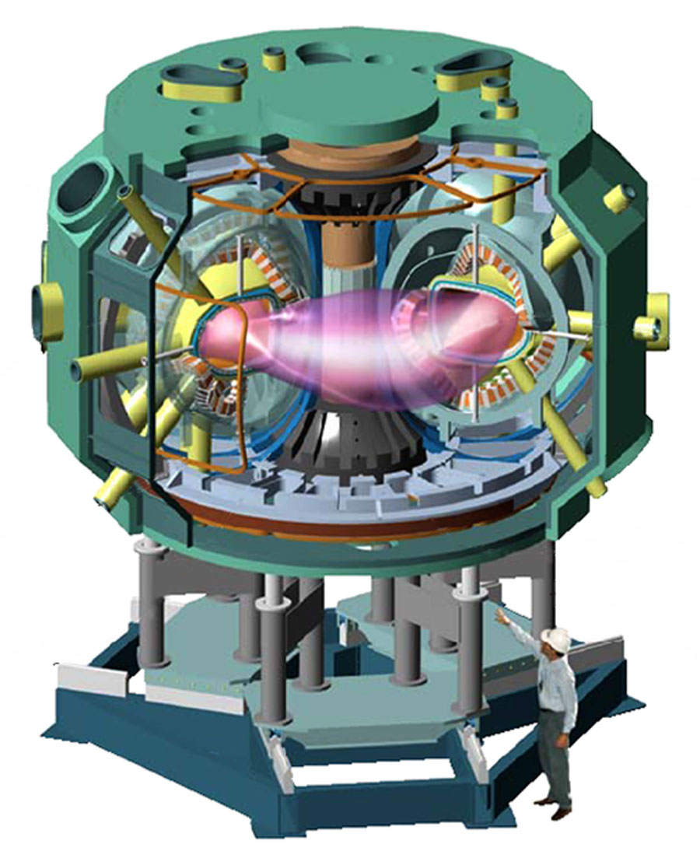
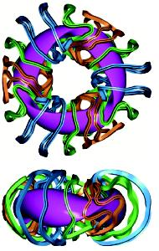
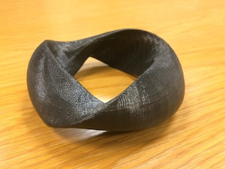
Visualizing fusion reactor devices using 3D prints
National Spherical Torus Experiment (NSTX)
3D models have also been used in the lab to model the larger scale machines and their equilibrium plasmas.
Complicated plasma geometries (like those of a stellerator plasma) can be better visualized using 3D models.
National Compact Stellerator Experiment (NCSX)

Slide 36
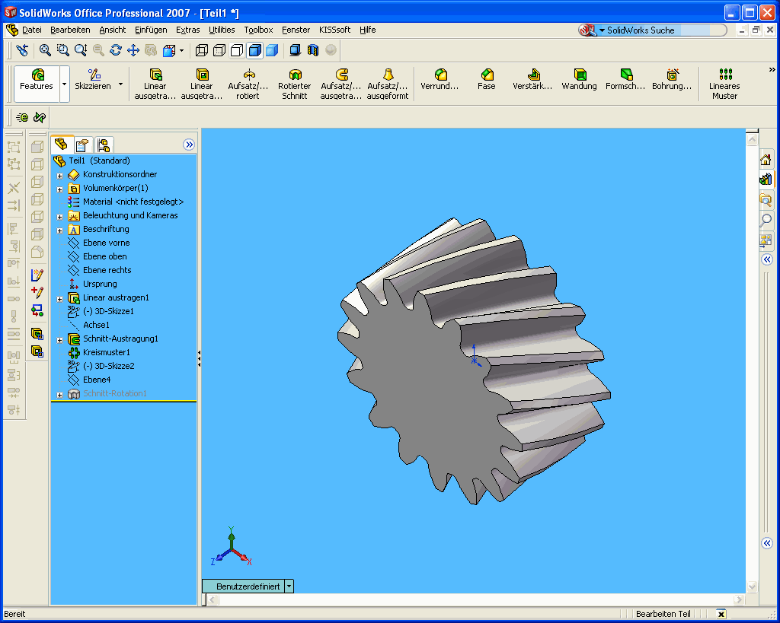
3D printing is a great tool for student learning
-3D printing helps develop computer and hands-on skills in students.
-It introduces students to CAD software and technical drawings. We use Solidworks and Autocad.
-They can quickly make replacement pieces of broken components and even improve them.
-Ultimately, it provides independence for them in the lab. Students get to problem solve and quickly iterate and perfect designs.
Notes:
----- Meeting Notes (1/8/16 14:22) -----
Better intro to where the students come in

Slide 37
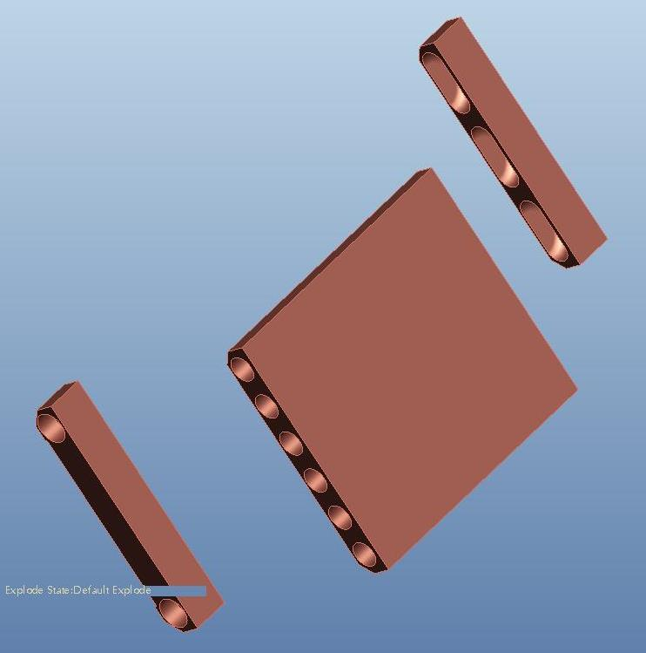
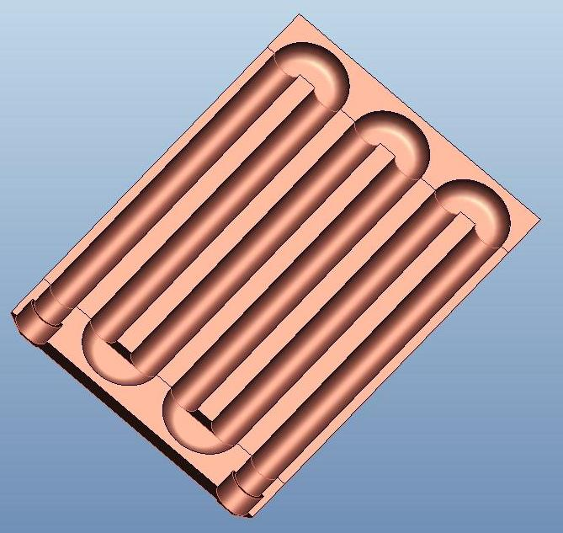

Beyond plastics
Machine shop design
-Recently, a PPPL project needed a microwave mirror with cooling channels inside.
-Typically, an internal cooling channel would be machined as shown in the figure, with drill bit circular holes.
-The circular channels are not optimal for homogeneous cooling. A better channel cross section is shown below:

Slide 38
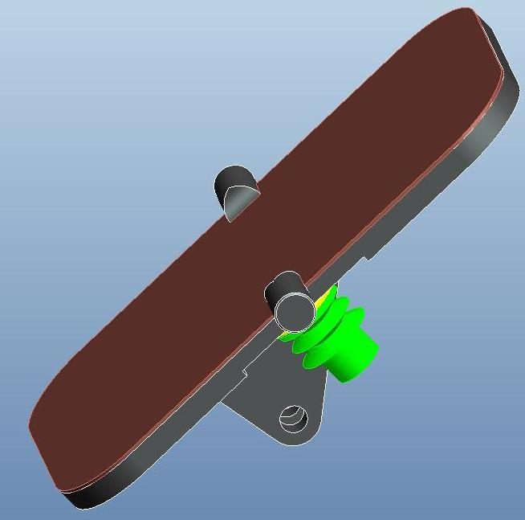
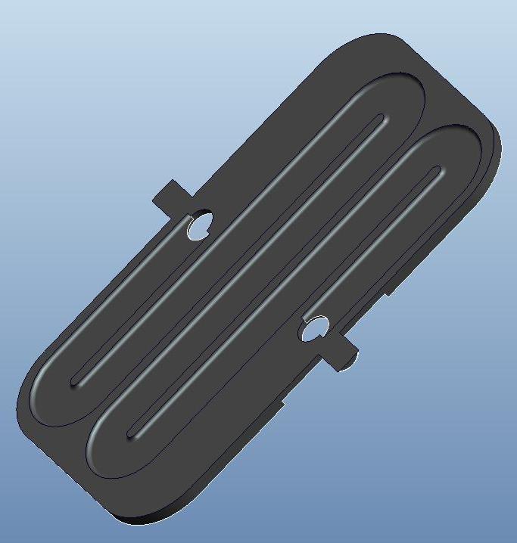
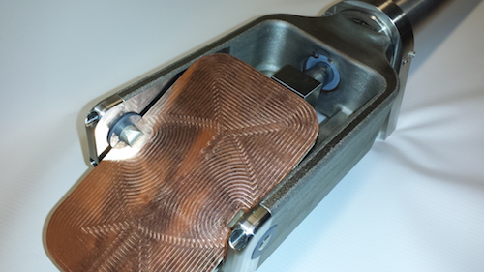
Beyond plastics
Machine shop design
-Robert Ellis (PPPL Engineer), designed and modeled a mirror with custom non-circular channels.
-The mirror was 3D printed in metal by Imperial Machine & Tool Co. and its cost was comparable to what a standard mirror would cost to produce in the PPPL machine shop.
3D print design
Stainless steel
Copper

Slide 39
Conclusions
-Suitability of PLA 3D printing has been tested for a plasma physics laboratory environment using a Makerbot Replicator 2 printer.
-Prints were found to be accurate to up to 50μm for prints of 1cm-4cm in size.
-Tensile strengths have been measured. At 100% infill, the strength is 60.6MPa, comparable to previous results.
-PLA is found suitable for high vacuum use (>10⁻⁶Torr) when temperature is maintained below 75°C.
-PLA has been used for Dielectric Barrier Discharge setups and has been found suitable at high infill values.
-Finally, metal 3D printing has now been used in the lab at costs comparable to machine shop costs.

Slide 40
Links
Thanks for your attention!
PPPL Science Education Department:
http://www.pppl.gov/education/science-education
Remote Glow Discharge Experiment:
http://scied-web.pppl.gov/rgdx/
(Or Google: “PPPL remote”)

Slide 41
EXTRA SLIDES

Slide 42
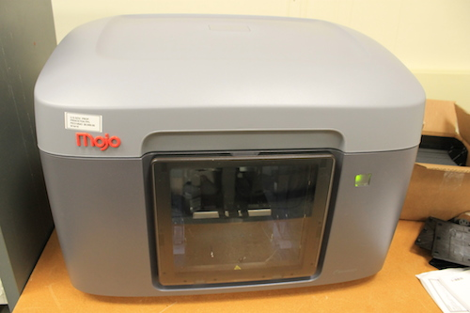
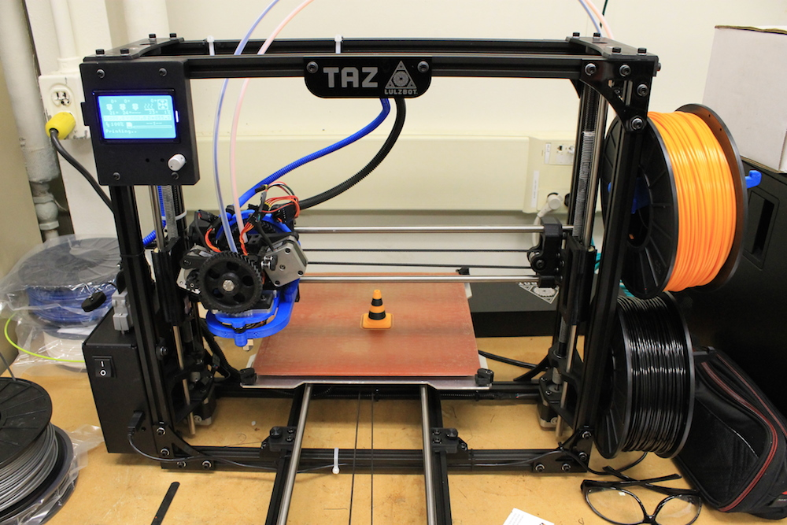

We’ve recently acquired some new “toys”
-With the new acquisitions: The Stratasys Mojo and the LulzBot TAZ 5, we’re now able to print with double filament are with dissolvable structures.
-They’re a bit pricier than the Makerbot (e.g. Mojo cartridges are about $400 each) but not by an order of magnitude (like metal printers).
-We’re just getting started but we’re excited about the possibilities.

