Slide 1
Investigating the Effects of Learning Assistant (LA) -Supported Active Learning Environments: LA As Mediators in the classroom
AAPT CONFERENCE 2017
Mary Nyaema,¹ Idaykis Rodriguez,¹ Oscar Diaz,¹ Hagit Kornreich-Leshem,¹ Laird H. Kramer,¹ Chelsey Grassie,² Andrew McDevitt,² Jeff Boyer,² Amreen Nasim Thompson,³ Paul Le,³ Leanne Doughty,³ Laurel Hartley,³ Robert Talbot ³
1. Florida International University, 2. North Dakota State University, 3. University of Colorado Denver
NSF Project # 1525115

Slide 2
History of the Beyond Project
Started in 2015.
Initiated to study learning assistant (LA)- active learning environment primarily in large introductory science classrooms.
LA increase student understanding of concepts & their attitude towards learning especially in active learning environments.¹
Goal: Develop a model for LA engaging students across multiple classrooms, multiple science disciplines and multiple universities.
Using Activity Theory as framework for LAs in active learning environment.
This talk focuses on establishing the role of LAs using Activity Theory.
Notes:
Otero, Pollock, McCray & Finkelstein, 2006, Van Dusen, Langdon & Otero, 2015

Slide 3
LA as mediators of science learning in active learning environments
Jonassen & Rohrer-Murphy (1999)
Jonassen & Rohrer-Murphy (1999)

Slide 4
LA as mediators of science learning in active learning environments
Jonassen & Rohrer-Murphy (1999)
Jonassen & Rohrer-Murphy (1999)

Slide 5
LA as mediators of science learning in active learning environments
Student
Jonassen & Rohrer-Murphy (1999)
Jonassen & Rohrer-Murphy (1999)

Slide 6
LA as mediators of science learning in active learning environments
Student
Learning
Jonassen & Rohrer-Murphy (1999)
Jonassen & Rohrer-Murphy (1999)

Slide 7
LA as mediators of science learning in active learning environments
LA as mediators
Student
Learning
Jonassen & Rohrer-Murphy (1999)
Jonassen & Rohrer-Murphy (1999)

Slide 8
LA as mediators of science learning in active learning environments
LA as mediators
Learning gains, course retention, persistence in major
Student
Learning
Jonassen & Rohrer-Murphy (1999)
Jonassen & Rohrer-Murphy (1999)

Slide 9
LA as mediators of science learning in active learning environments
LA as mediators
Learning gains, course retention, persistence in major
Student
Learning
Jonassen & Rohrer-Murphy (1999)
Jonassen & Rohrer-Murphy (1999)

Slide 10
LA as mediators of science learning in active learning environments
LA as mediators
Learning gains, course retention, persistence in major
Student
Learning
Jonassen & Rohrer-Murphy (1999)
Jonassen & Rohrer-Murphy (1999)

Slide 11
LA as mediators of science learning in active learning environments
LA as mediators
Learning gains, course retention, persistence in major
Student
Learning
LA Responsibilities
Jonassen & Rohrer-Murphy (1999)
Jonassen & Rohrer-Murphy (1999)

Slide 12
LA as mediators of science learning in active learning environments
LA as mediators
Learning gains, course retention, persistence in major
Student
Learning
LA, students and instructors
LA Responsibilities
Jonassen & Rohrer-Murphy (1999)
Jonassen & Rohrer-Murphy (1999)

Slide 13
LA as mediators of science learning in active learning environments
LA as mediators
Learning gains, course retention, persistence in major
Student
Learning
Negotiated classroom interaction rules
LA, students and instructors
LA Responsibilities
Jonassen & Rohrer-Murphy (1999)
Jonassen & Rohrer-Murphy (1999)

Slide 14
LA as mediators of science learning in active learning environments
LA as mediators
Learning gains, course retention, persistence in major
Student
Learning
Negotiated classroom interaction rules
LA, students and instructors
LA Responsibilities
Jonassen & Rohrer-Murphy (1999)
Jonassen & Rohrer-Murphy (1999)

Slide 15
LA as mediators of science learning in active learning environments
LA as mediators
Learning gains, course retention, persistence in major
Student
Learning
Negotiated classroom interaction rules
LA, students and instructors
LA Responsibilities
Jonassen & Rohrer-Murphy (1999)

Slide 16
Research summary
Purpose of the study: to establish the role of LA in terms of Activity Theory.
Research questions:
What are student perceptions of LA roles in the classroom?
What are faculty perceptions of LA roles in the classroom?
How to interpret their roles in activity theory.

Slide 17
Research summary
Research Design: Comparative case study research.
Participants: 462 undergraduate students, 37 LA and 5 instructors.
Instructors had 1-5 years experience teaching with LA in their classrooms.
1 Physics, 2 Biology, & 2 Chemistry lower division courses.
Research Instruments: Students surveys and instructor interviews.
Face validation of survey items through student interviews.

Slide 18
Data analysis
Triangulation of data to compare agreement between instructors, students and LA .
Further classification of LA roles into three main roles that promote student learning in active learning classrooms.

Slide 19
mediating student understanding
Mediating student understanding
The LA explain how to solve a problem or how I can reach an answer in class
The LA clarify questions posed by the instructor to help me understand
The LA ask guiding questions to help me get to the answer myself
Students perceive LA as mediators of student understanding.
Never- the instructor has not asked me to do this activity in this course
Sometimes- the instructor asks me to do this activity less than weekly
Often- The instructor asks me to do this activity at least once a week
Notes:
In all 5 courses, majority of student indicate that this role happens often (5 different contexts we conclude that LA mediate student understanding)

Slide 20
Mediating Student understanding
“LA probe or ask leading questions in order to guide students when answering questions.”- Instructor 2
“LA clarify things that are said which the students may not understand.” – Instructor 5
Instructors agree that LA mediate student understanding.

Slide 21
Mediating STUDENT success
Mediate student success
The LA share information about their experience in this course
The LA share tips on how to study for the exam/quiz/final
The LA talk to me about how to be successful in the class
Students perceive LA as mediators of student success

Slide 22
Mediating student success
“LA speak about themselves during the first lecture and say what they did to be successful in the class.” - Instructor 4
“ LA talk to students about how to be successful in the course.” - Instructor 3
Instructors agree that LA mediate student success.

Slide 23
Mediating Classroom motivation
Mediating classroom motivation
The LA encourage me to think about my prior knowledge or experiences to answer a question
The LA encourages me to consider multiple perspectives.
Students perceive LA as mediators of classroom motivation.
Never- the instructor has not asked me to do this activity in this course
Sometimes- the instructor asks me to do this activity less than weekly
Often- The instructor asks me to do this activity at least once a week

Slide 24
Mediating classroom motivation
“ LA are instructed to ask students to think about past experiences, what they have done in previous classes and how that ties in to the material being covered.” – Instructor 1
Instructors agree that LA mediate classroom motivation.

Slide 25
UNDERSTANDING LA: ACTIVITY THEORY CONTEXT
LA as mediators
Student understanding
Classroom motivation
Student success
Student
Learning

Slide 26
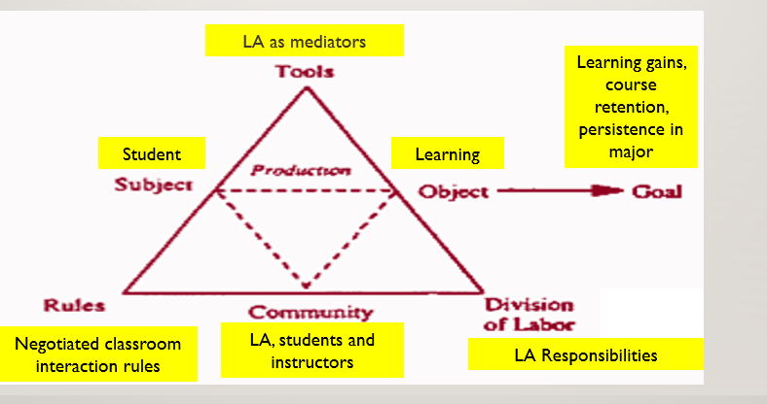
CONCLUSION/IMPLICATIONs
Foundation for continuing development of activity theory model for LA engagement in the science classrooms.
Helpful for instructors while planning LA-mediated activities in the classroom for more meaningful classroom interaction.

Slide 27
Thank you!
More on this:
PERC Poster Presentation (A48)
Date: Wednesday July 26, 2017
Time: 4:00 P.M.
Location: Event Center 1

