Slide 1
Seeking Exoplanets with Inexpensive Cameras
Martin Connors
Athabasca University, Alberta, Canada
Olivier Guyon
University of Arizona, Tucson
Josh Walawender
Subaru Telescope, Mauna Kea, Hawai’i
American Association of Physics Teachers Winter Meeting 2015
San Diego, California

Slide 2
About the Background Image
Nikon D5100 (basic DSLR camera)
Feb. 9 2014 6:42 UT 30 seconds
4928x3264 pixels, 24 bit
ISO-3200 f/4.2 86mm zoom (129 eq.)
Stars to 12 or 13 magnitude
15.7x10.4 Degrees
Satellite track!
Variable star! (U Cep, ca. 7-10 mag.)

Slide 3
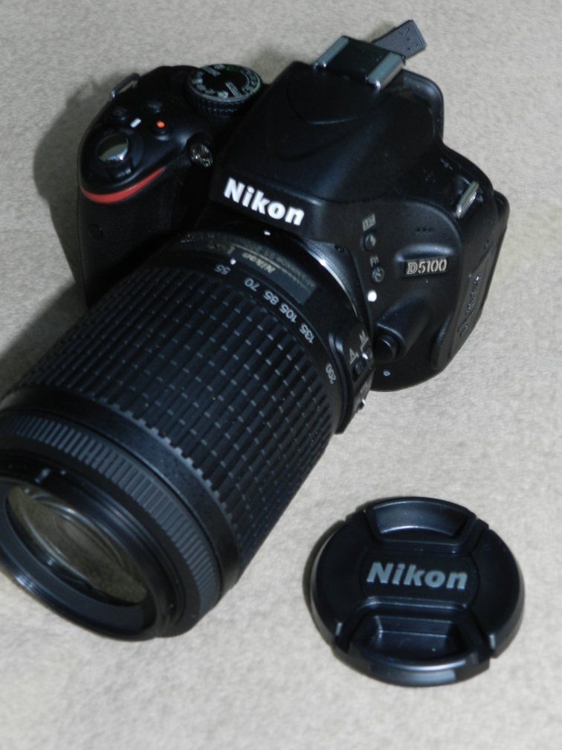
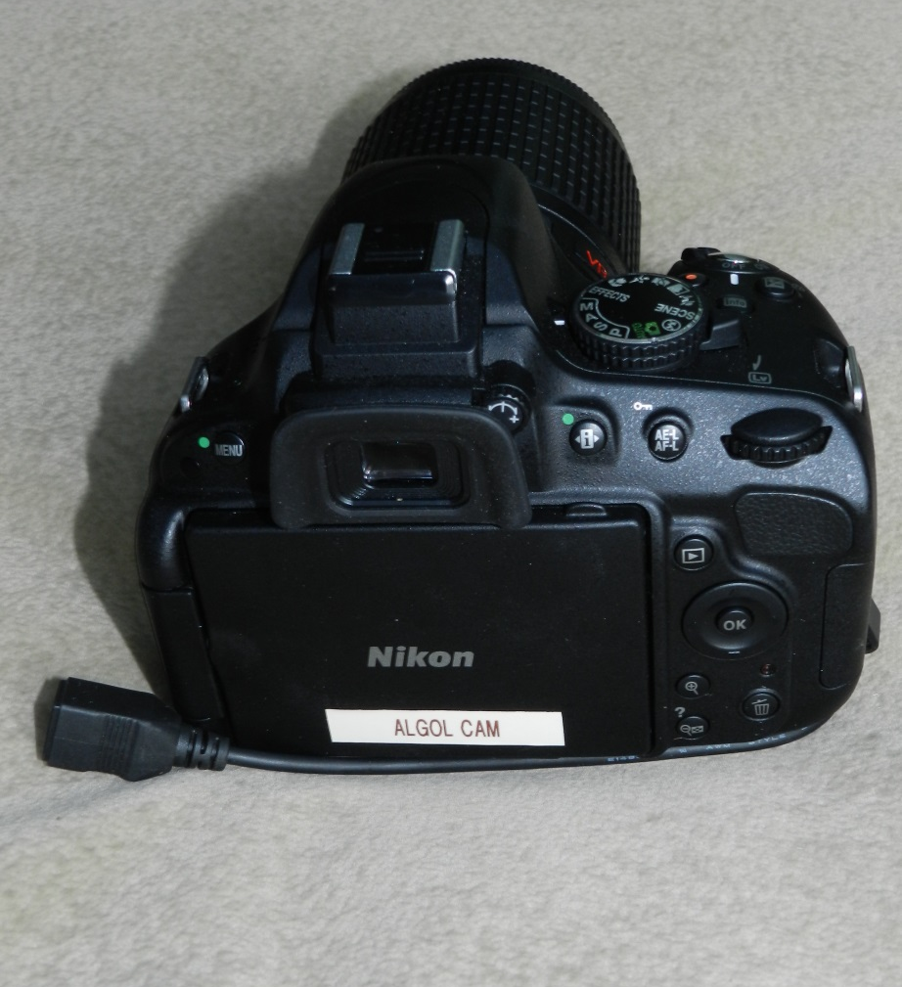
What is a DSLR Camera?
DSLR means Digital Single Lens Reflex. Derives from SLR film cameras where a reflex mirror system allows viewfinding and focus through the single lens.
Note: modern trend to mirrorless digital cameras, have similarities
Some aspects apply to point-and-shoot low end cameras, but in general these are NOT suitable for standalone dark sky photography
Body
Compact Size
Viewfinders
Interchangeable lenses
Power
Lens cap (filters)
USB (not shown)

Slide 4
Advantages of DSLR
Digital Imaging
  Instant gratification
  Digital manipulation (storage, processing)
Low Cost and General Purpose camera
  ca. $500 and you may already have one
High sensitivity (ISO 6400 or greater)
High resolution (typically 4000*3000 or more)
Low power
  300 exposures on battery, power supplies available
Computer connectable for data and control
  May have built-in “interval shooting mode”
Light weight and compact
Many lenses available including fast lenses ($$$)
Mounting screw for tripod or mount
There are some downsides too, not dealt with here!
  But one downside cannot be avoided

Slide 5
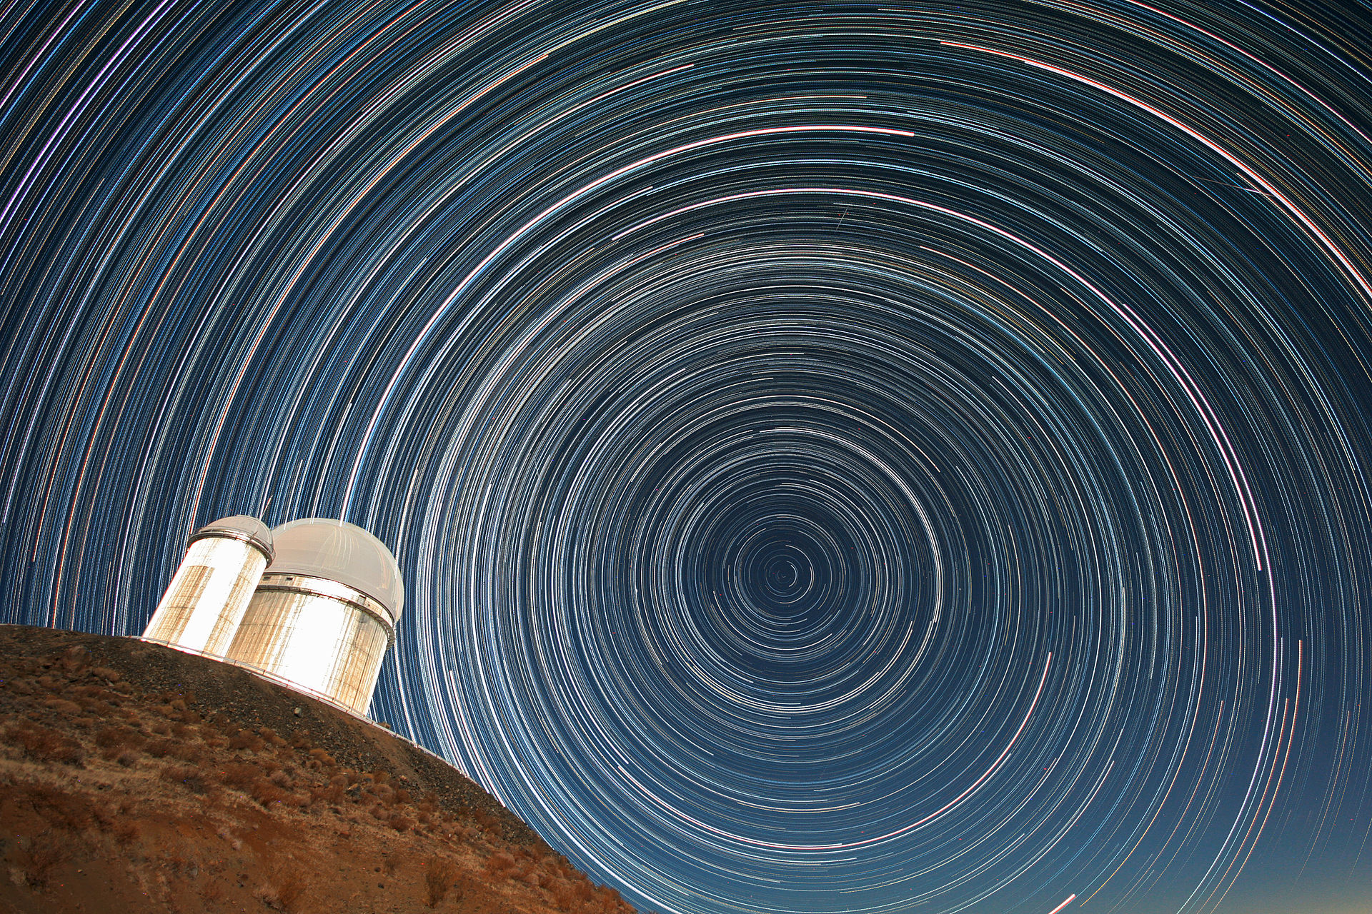

The Trials of Trails
For exposures longer than a few seconds, even on a tripod, Earth’s rotation causes stars to trail
http://www.eso.org/public/images/271109-cc/

Slide 6
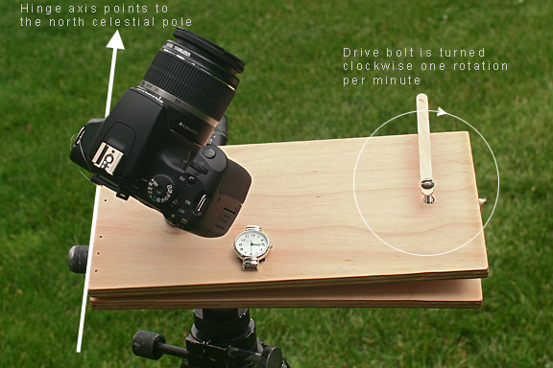
Barn Door Tracker
To do fairly wide field photography tracking stars, a very simple setup will move you far beyond star trails.
A simple hinge (not clearly visible) pointed at the pole (camera is on a ball mount) and screw allow compensating for Earth’s rotation.
http://www.astropix.com/BGDA/SAMPLE2/SAMPLE2.HTM
Note: image permission not sought but if you go to the site you can buy the e-book A Beginner's Guide to DSLR Astrophotography and then the author (Jerry Lodriguss) will likely forgive me! http://www.astropix.com/BGDA/BGDA.HTM

Slide 7
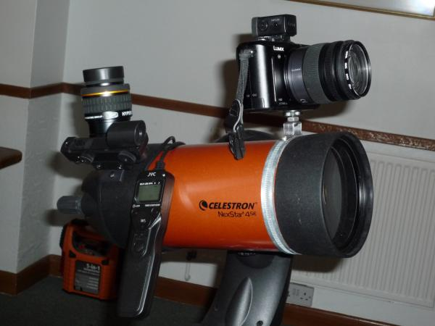
What use is a telescope, anyway?
http://www.astronomyforum.net/celestron-nexstar-telescope-forum/124907-making-piggy-back-camera-mount-se4.html (image by “pushrod” believed to be in public domain)
You can mount a DSLR on a telescope and likely get better results easier than through the telescope (which also takes an adapter). Especially handy if the telescope has “GO TO” functions, BUT not in altazimuth mode.

Slide 8
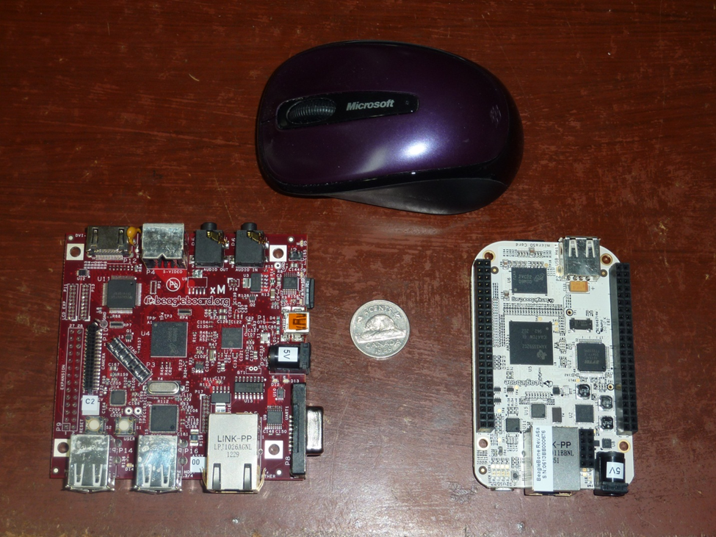
Computer Control
Once the camera is mounted and driven, opening the shutter must be done without vibration.
This can be done by time delay found on almost all cameras.
Possibly an internal intervalometer is available, or a remote.
Another way is to use a small computer such as a laptop (Windows or linux) or board.
They can download images too.
Linux control software is usually gphoto2
Linux Beagleboard (more USB ports) and Beaglebone (smaller)

Slide 9
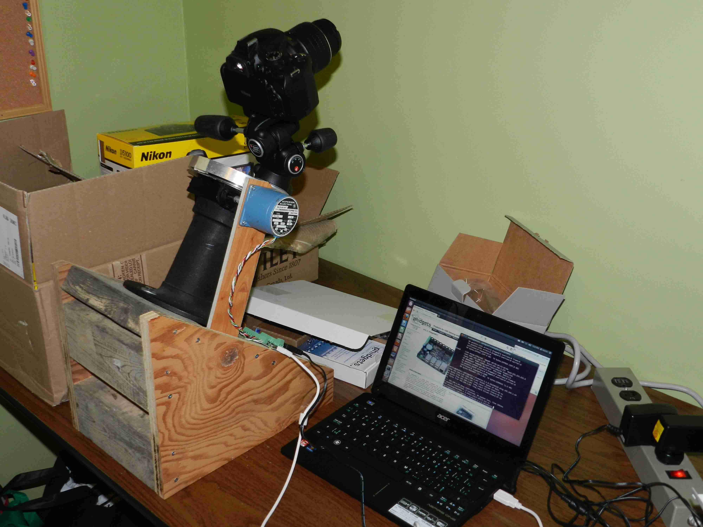
Going all the way - Algolcam
Once using a computer to control the camera, why not the whole system?
Algolcam is a prototype computer controlled camera, with a linux laptop. In the first prototype, only the RA axis was driven by a stepper motor attached to a “Phidgets” controller. The camera was controlled by USB, with image downloads.

Slide 10
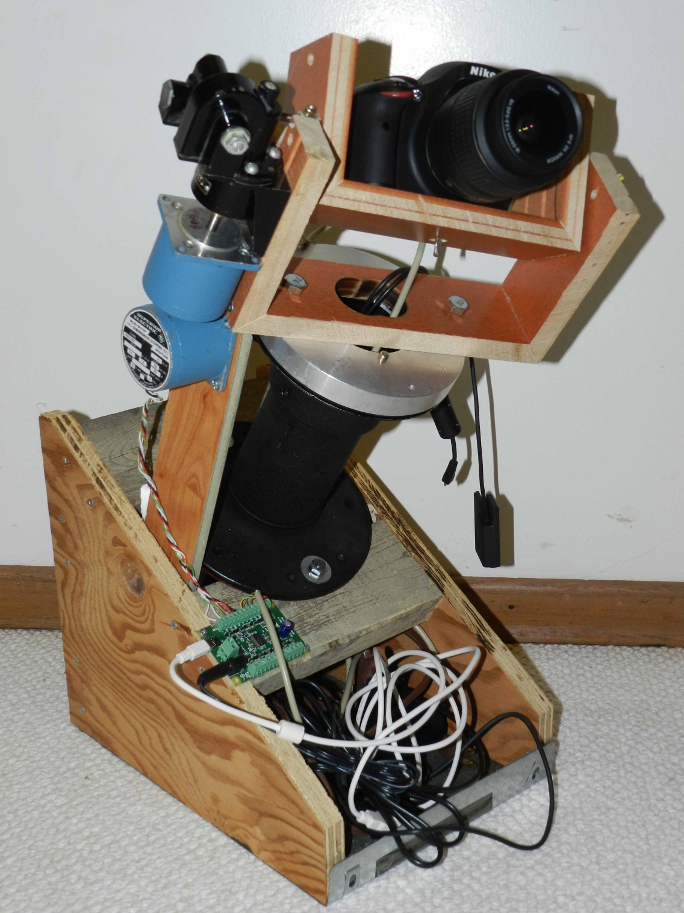
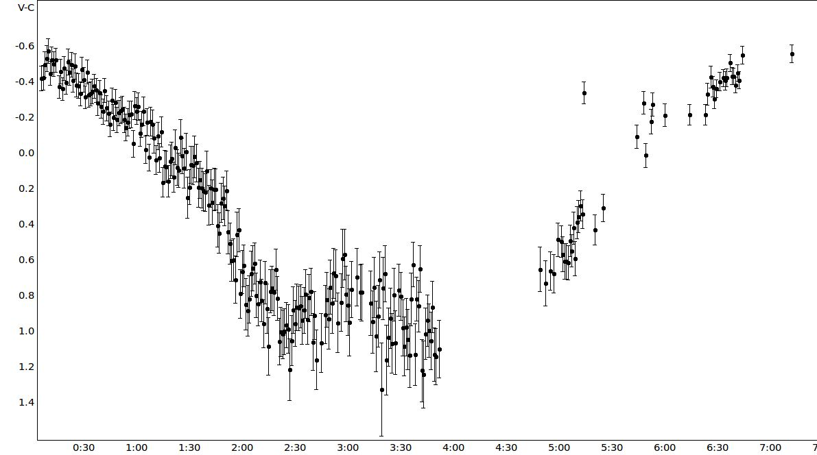
Full Algolcam. Driven declination cradle in place, Beaglebone control, used over Ethernet from under a clear plastic dome.
U Cep bottom part of light curve.
10th magnitude

Slide 11
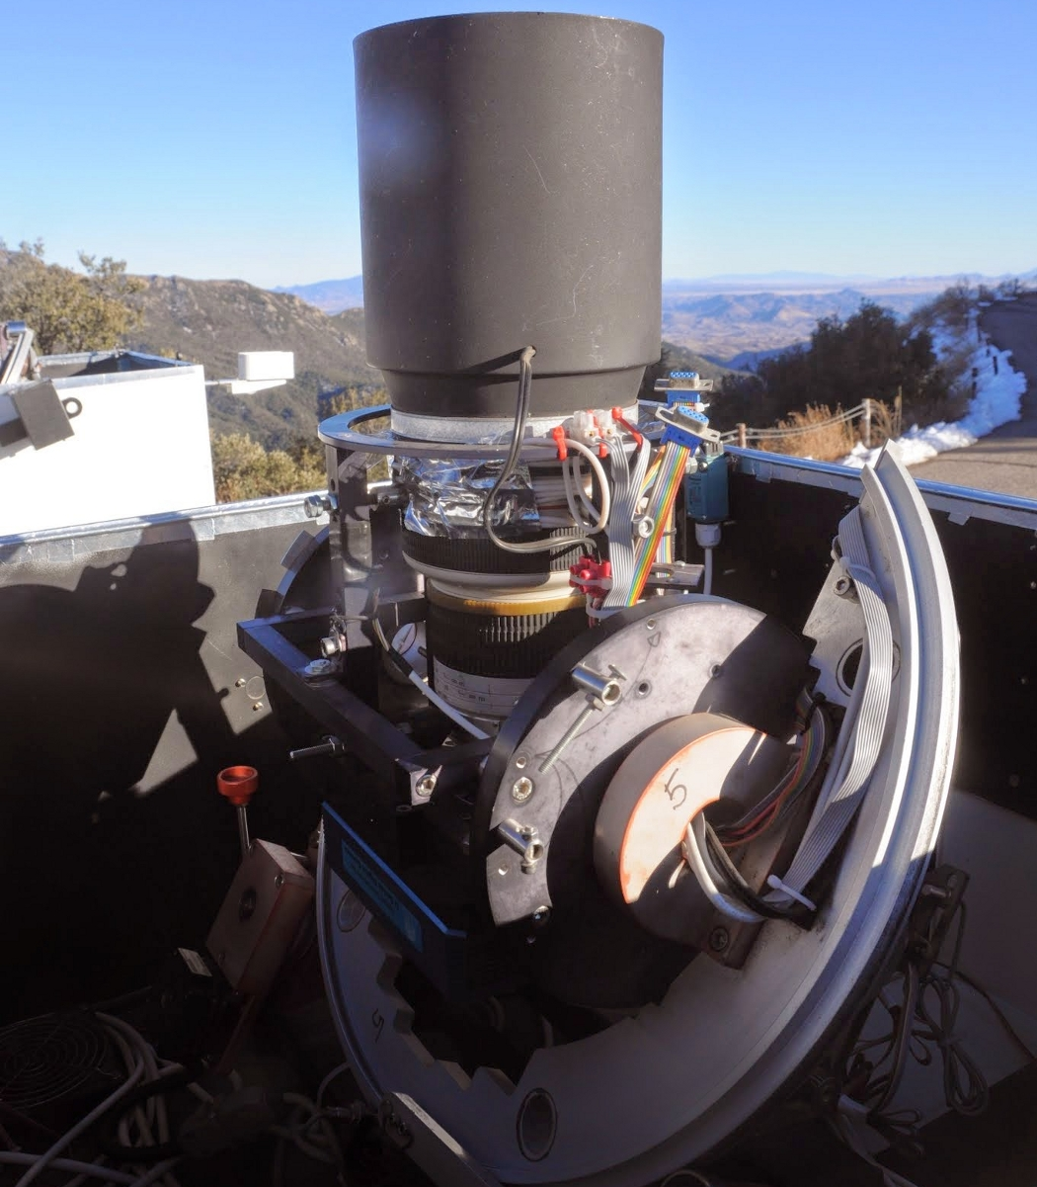
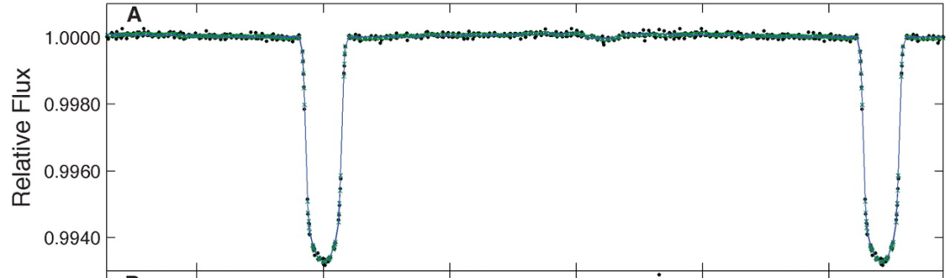
Can we detect exoplanets with a camera lens? We already have!
The HAT (Hungarian Automated Telescope) project uses a worldwide network of CCD cameras with standard 200mm camera lenses to look for exoplanets.
HAT P-1b, discovered in 2006, dims a 10.4 mag star by 0.6% every 4.5 days. HAT P-7 as observed by Kepler has 2.2 day period and similar amplitude. A secondary eclipse is visible. Cameras can discover such “hot Jupiters” for followup. ©Science Magazine, fair use provision
hatnet.org

Slide 12
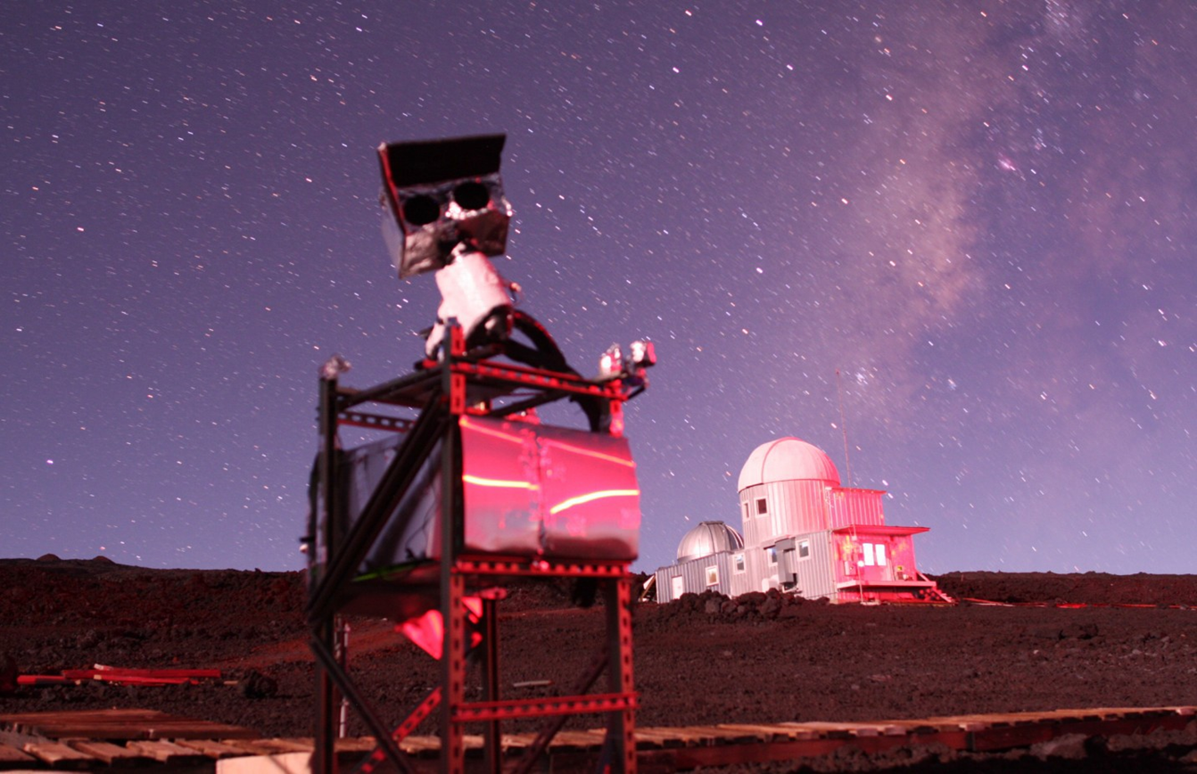
Project Panoptes
Testing version 2 unit on Mauna Kea. 2 cameras are in an enclosure. Electronics box below.

Slide 13
Panoptes Hardware
Panoptes is a dual camera system on a commercial mount. The cameras are enclosed for weather protection. Commercial parts are used as much as possible. Cost a few thousand $.

Slide 14
Enclosure Details
Local control board is an Arduino
Preferred lens is Rokinon 85 mm f/1.4, ~$300

Slide 15
Panoptes Progress
Currently building the baseline unit and writing software to run it
Recruiting first generation of builders, upon whom success depends
Panoptes participation is open to all.
Can participate on many levels: build a unit, write code, process data, improve hardware, provide a site, follow-up on interesting targets with other telescopes, etc.
email: info@projectpanoptes.org
web: www.ProjectPanoptes.org
Social: Google Groups and Google+: Project Panoptes
Software: https://github.com/panoptes

Slide 16
Thank you!
Summary
DSLR astrophotography is easy to do, although a dark sky location is helpful
A simple barndoor mount will achieve astonishing results
Mounting a camera piggyback on a telescope can give better results than photographing through the telescope
You can make your own computer controlled astronomical camera
You can join Project Panoptes and benefit from shared experience and data processing to possibly discover exoplanets

