Slide 1
The Effect of Online Lecture on Persistence in a Physics Class
Dr. John Stewart

Slide 2
Abstract
This talk will examine the difference in the rate students successfully complete a physics class between students attending lecture in person and students choosing to watch the lecture on video as part of an online class. The option to watch the lecture on video was implemented mid-semester in Fall 2012 so that the performance of the same set of students could be compared. A fully online lecture section was introduced in Spring 2013, but students were allowed to select the lecture viewing option. The online lecture section was continued in the Fall 2013 and Spring 2014 semesters; however, students were no longer allowed the choice of lecture viewing option. Higher than expect withdrawal rates have been experienced in the online sections of the class. These will be examined in the context of the historical performance of the class and the differences in engagement in the class measured by the rate at which students submit required assignments.

Slide 3
Context

Slide 4
University Physics II
The course studied is the second-semester, calculus-based, introductory physics class at the University of Arkansas.
The class has been presented in the same format by the same lead instructor for over a decade.
The course features interactive laboratories, excellent TA training, and has been a centerpiece of the Arkansas Physics Program and its PhysTEC site.

Slide 5
Course Structure (Before Online)
Lecture was presented during two 50-minutes sessions each week with attendance managed with a lecture quiz.
Two two-hour laboratory sessions were required each week involving hands-on activities, small group work, traditional experiments, and interactive demonstrations.
Students were required to turn in open-response and multiple-choice homework before each lecture.

Slide 6
Course Structure (After Online)
Online and Face-to-Face (f2f) lecture sections were offered both presenting the same 50 minute lecture twice a week.
Online lecture sections used videos of the f2f lecture cut into 5-15 minute segments each accompanied by a lecture quiz question.
The laboratory experience was unchanged.
Students were required to turn in open-response homework after the last lab and multiple-choice homework before each lecture.

Slide 7
In Short
The class was virtually unchanged by the introduction of the online option except some students could watch the lecture on video.

Slide 8
The Problem

Slide 9
DFW Rates
Students who receive a D or F after completing the class or withdraw with a W are required to retake the class to progress in toward their degree.
The fraction of enrolled students receiving D, F, or W, the DFW rate, represents the fraction of students who have not successfully completed the class.

Slide 10
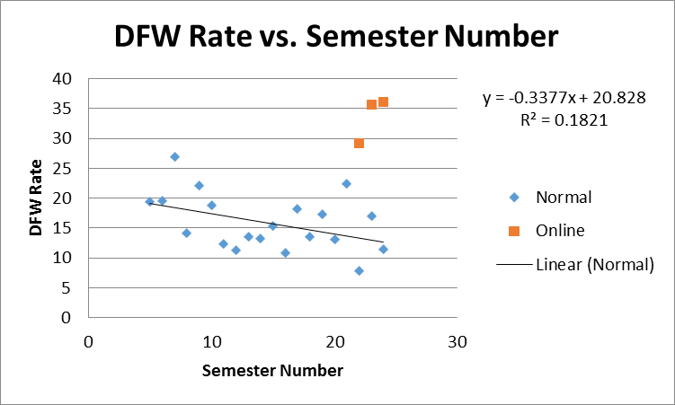
Online Students Fail at Higher Rates

Slide 11
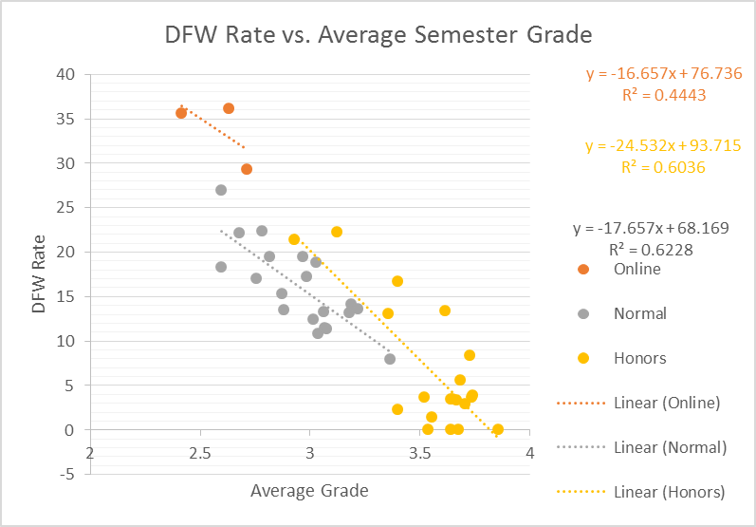
Online Students are Weaker, but that is not the explanation

Slide 12
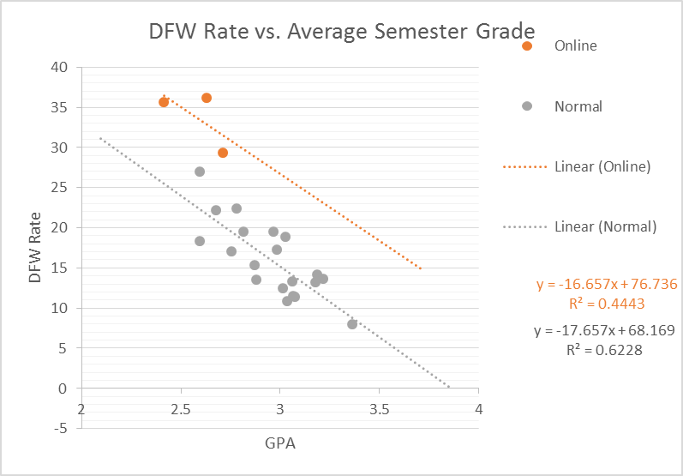
Online Students are Weaker, but that is not the explanation

Slide 13
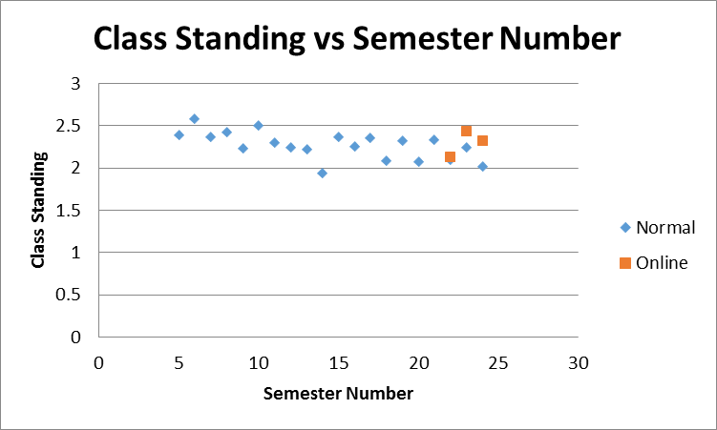
Maybe Online Students are Younger

Slide 14
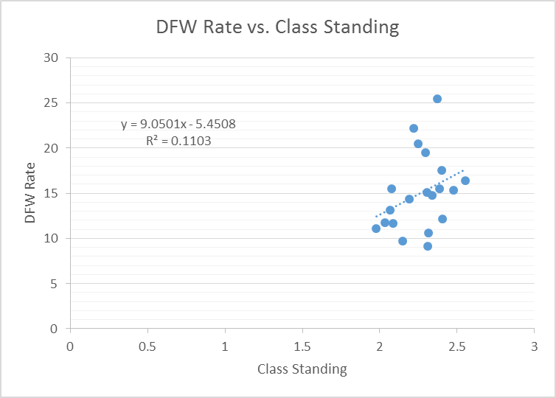
Class Standing does not seem to matter

Slide 15
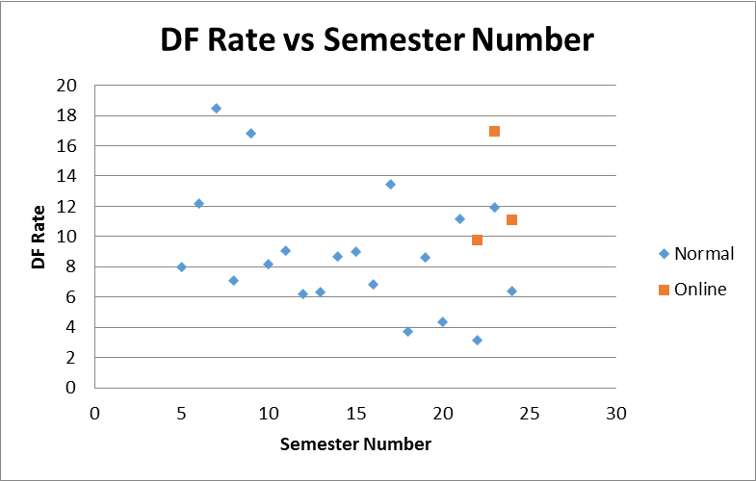
DF Rate within range

Slide 16
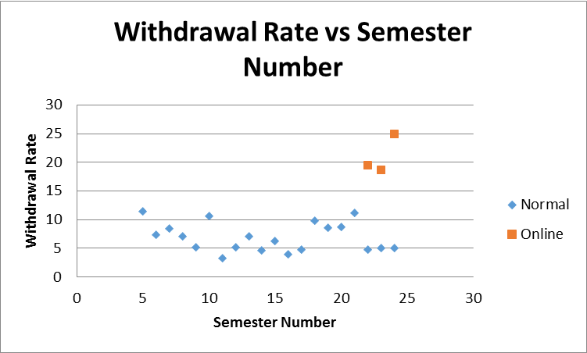
The Withdrawal rate is not

Slide 17
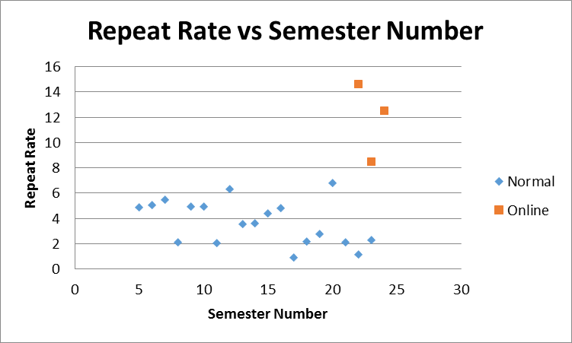
More Online Students are Repeating the class

Slide 18
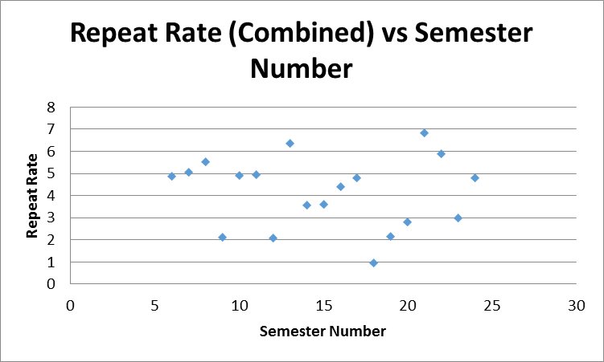
Repeating Students electing online sections

Slide 19
And not Succeeding

Slide 20
Why did you take the online class?
 | N | A | B | C | D | F
The face-to-face lecture section was full and this was the only way I could get into the class. | 18 | 44 | 40 | 44 | 33 | 50
There was another class I wanted to take at the same time as the lecture. | 16 | 56 | 35 | 44 | 0 | 0
I had personal or work commitments that conflicted with the face-to-face lecture. | 2 | 0 | 5 | 0 | 33 | 0
I like the flexibility of an online class. | 7 | 0 | 20 | 11 | 33 | 50
I think I learn better using online lectures than face-to-face lectures. | 0 | 0 | 0 | 0 | 0 | 0
N |  | 9 | 20 | 9 | 3 | 2
Values in percent.

Slide 21
Would you switch to f2f if you could?
 | N | A | B | C | D | F | Average
yes | 27 | 44 | 60 | 89 | 67 | 50 | 63
no | 16 | 56 | 40 | 11 | 33 | 50 | 37
Total N | 43 | 9 | 20 | 9 | 3 | 2
Values in percent.

Slide 22
Persistence of “W” students
 | Tests Taken | 1 | 2 | 3 | 4
Before Online (Fall 11-Spring 12)
Normal |  | 88.24 | 61.76 | 35.29 | 0.00
After Online (Fall 13-Spring 14)
Normal |  | 100.00 | 73.33 | 13.33 | 0.00
Online |  | 71.43 | 38.10 | 9.52 | 0.00
Percentage of students taking the four tests.

Slide 23
Compare Repeating Students
 | Test Taken | 1 | 2 | 3 | 4
Before Online - First Time Students
Normal |  | 87.88 | 60.61 | 36.36 | 0.00
Before Online - Repeating Students
Normal |  | 100.00 | 100.00 | 0.00 | 0.00
After Online - First Time Students
Normal |  | 100.00 | 78.57 | 14.29 | 0.00
Online |  | 85.71 | 57.14 | 14.29 | 0.00
After Online - Repeating Students
Normal |  | 100.00 | 0.00 | 0.00 | 0.00
Online |  | 42.86 | 0.00 | 0.00 | 0.00

Slide 24
Success Rate of Repeating Students
 | Students Receiving A, B, C
Fall 11-Spring 12 |  | Total | Non-Online | Online
 | Total Enrollment | 463
 | Students Repeating | 11 | 11
 | Repeat Rate (%) | 2.38
 | Successful Repeats | 8 | 8
 | Success Rate (%) | 72.73 | 72.73
Fall 13-Spring 14
 | Total Enrollment | 595 | 464 | 131
 | Students Repeating | 21 | 7 | 14
 | Repeat Rate (%) | 3.53 | 1.51 | 10.69
 | Successful Repeats | 7 | 5 | 2
 | Success Rate (%) | 33.33 | 71.43 | 14.29

Slide 25
W Rate Repeating STudents
 | Students Receiving W
Fall 11-Spring 12 |  | Total | Non-Online | Online
 | Total Enrollment | 463
 | Students Repeating | 11 | 11
 | Withdrawals | 1 | 1
 | Success Rate | 9.09 | 9.09
Fall 13-Spring 14
 | Total Enrollment | 595 | 464 | 131
 | Students Repeating | 21 | 7 | 14
 | Withdrawals | 8 | 1 | 7
 | Success Rate | 38.10 | 14.29 | 50.00

Slide 26
Not the whole problem
DFW Rate Correcting for Repeat Students |  | Total | Online
 | Total Enrollment | 595 | 131
 | Original DFW Count | 105 | 47
 | DFW Rate | 17.65 | 35.88
 | Corrected DFW | 98 | 40
 | Corrected Rate | 16.47 | 30.53

Slide 27
Engagement – Students not taking anY tests
 | Count | Non-Engaged | Low Engaged | High Engaged
Spring 2012
Normal | 4 | 0 | 100 | 0
Normal-First Time | 4 | 0 | 100 | 0
Normal-Repeat | 0
Spring 2014
Online | 5 | 80 | 20 | 0
Normal | 0
Online - Repeat | 4 | 75 | 25 | 0
Online-First Time | 1 | 100 | 0 | 0
Non-Engaged=No assignments submitted. Low-Engaged=<50% of assignments submitted. High-Engaged=>50% of assignments submitted.

Slide 28
Students Taking First Test who later withdrew
 | Count | Non-Engaged Percent | Low Engaged Percent | High Engaged Percent
Spring 2012
Normal | 17 | 0 | 6 | 94
Normal - First Time | 16 | 0 | 6 | 94
Normal - Repeat | 1 | 0 | 0 | 100
Spring 2014
Online | 13 | 0 | 23 | 77
Normal | 11 | 0 | 9 | 91
Online-Repeat | 2 | 0 | 50 | 50
Online-First Time | 11 | 0 | 18 | 82
Normal-Repeat | 1 | 0 | 0 | 100
Normal-First Time | 10 | 0 | 10 | 90

Slide 29
Conclusion
The replacement of face-to-face lecture with online lecture in a well-understood science class did not allow students repeating the class to succeed at the same rate as before the online option was made available.

