Slide 1
Modeling PeerWise and CLAS Technologies in Secondary Physics Teacher Education
Dr. Marina Milner-Bolotin
AAPT Winter National Meeting
February 18-21, 2017
Notes:
Abstract Information Session: Effective Practices in Educational Technologies Paper Type:Contributed Title:Modeling PeerWise and CLAS Technologies in Secondary Physics Teacher Education Meeting:2017 Winter Meeting: Atlanta, Georgia Location:N/A Date: Time:11:00AM Author:Marina Milner-Bolotin,, University of British Columbia, 16048224234, marina.milner-bolotin@ubc.ca Co-Author(s):None Abstract:For the past seven years we have been experimenting with a wide variety of technologies in secondary physics methods courses at the University of British Columbia. Some of these technologies are well known (PhET simulations, data collection tool, sensors). While other technologies, despite being freely available, are rarely used in teacher education. We have collected data on the effectiveness of the pedagogies that incorporated these “new” technologies for supporting the development of Pedagogical Content Knowledge of future physics teachers. In this talk we will discuss two of these technologies: PeerWise – an online database for collaboration on multiple-choice questions developed at the University of Auckland, NZ; and Collaborative Learning Annotation System (CLAS) developed at the University of British Columbia. We will also share our tips on how these technologies can be incorporate more effectively and how future physics teachers can use these technologies in their own teaching. Footnotes:None

Slide 2
Question Title
Question Title
Why CLAS?
Collaborative Learning Annotation System?

Slide 3
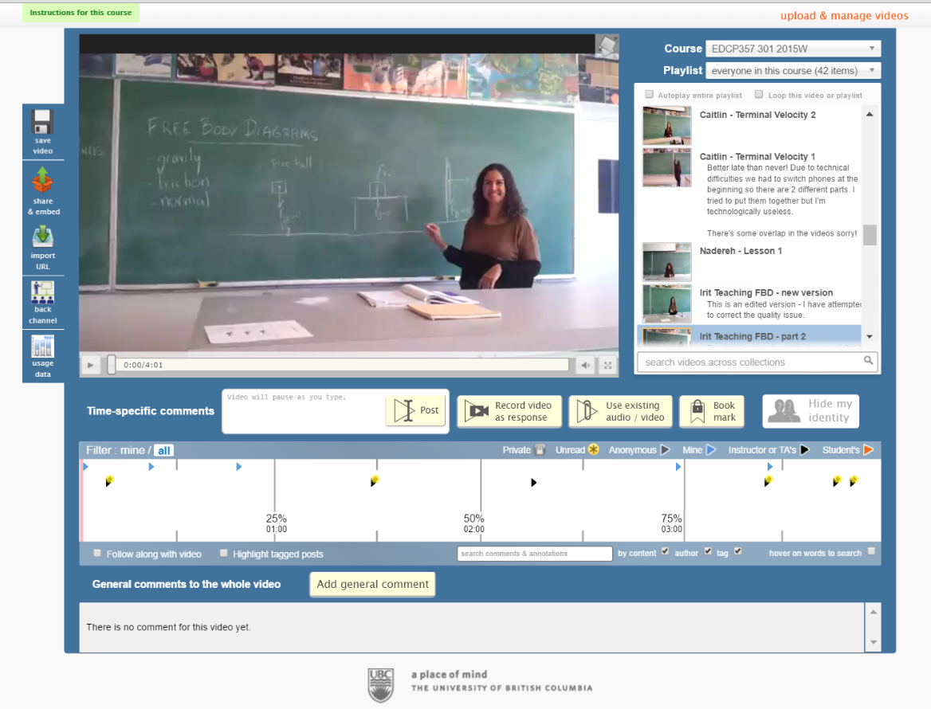
Question Title
Question Title
Examples of CLAS
Upload & manage videos
Annotate them
Collaborate
Share Learn from each other
Improve

Slide 4
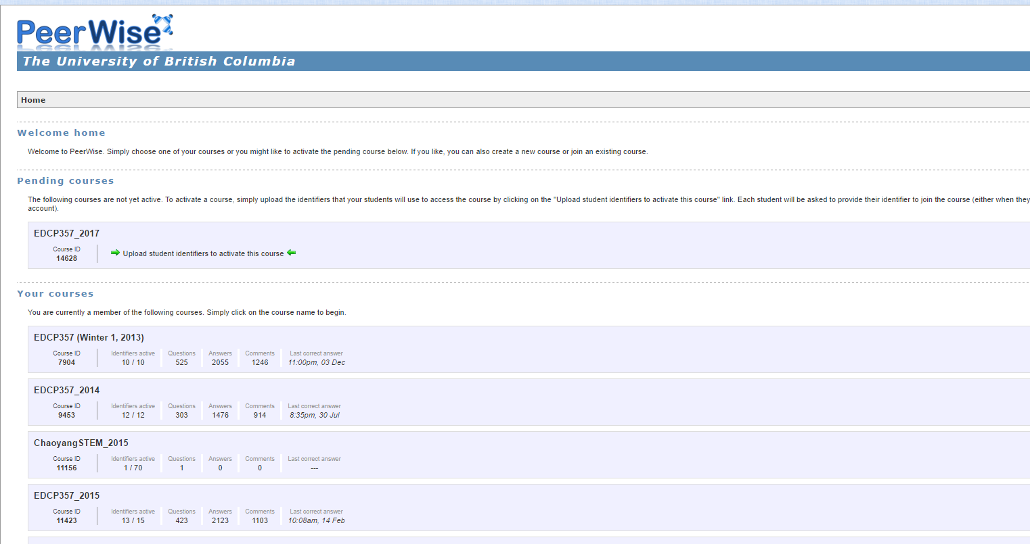
Question Title
Question Title
Why PeerWise
This resource promotes student collaboration on multiple-choice questions: content + pedagogy + technology

Slide 5
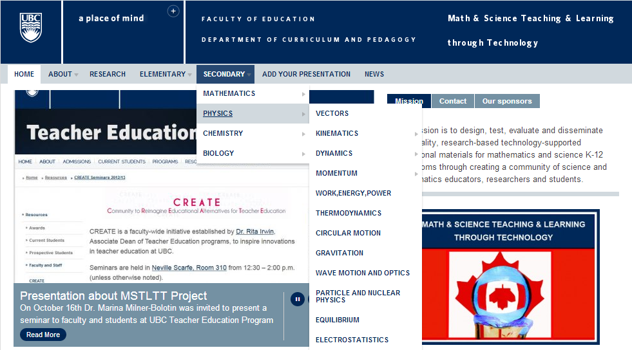
Research-Based Resource for Teachers
4
http://scienceres-edcp-educ.sites.olt.ubc.ca/
Notes:
This slides shows how our resource looks like. It is divided into primary and secondary, by subject area, and then by specific topics within each subject. These topics are determined largely by the British Columbia Ministry of Education and question sets in the database are developed to meet the Prescribed Learning Outcomes outlined in the Ministry documents.

Slide 6
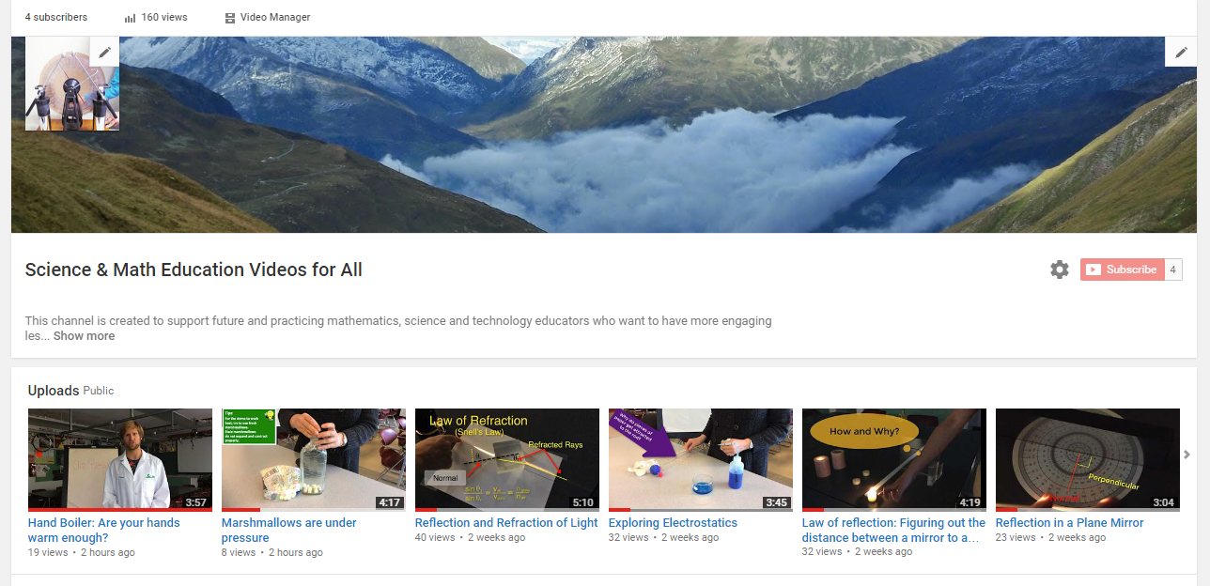
Research-Based Resource for Teachers
4
https://www.youtube.com/channel/UCHKp2Hd2k_dLjODXydn2-OA
Notes:
This slides shows how our resource looks like. It is divided into primary and secondary, by subject area, and then by specific topics within each subject. These topics are determined largely by the British Columbia Ministry of Education and question sets in the database are developed to meet the Prescribed Learning Outcomes outlined in the Ministry documents.

Slide 7
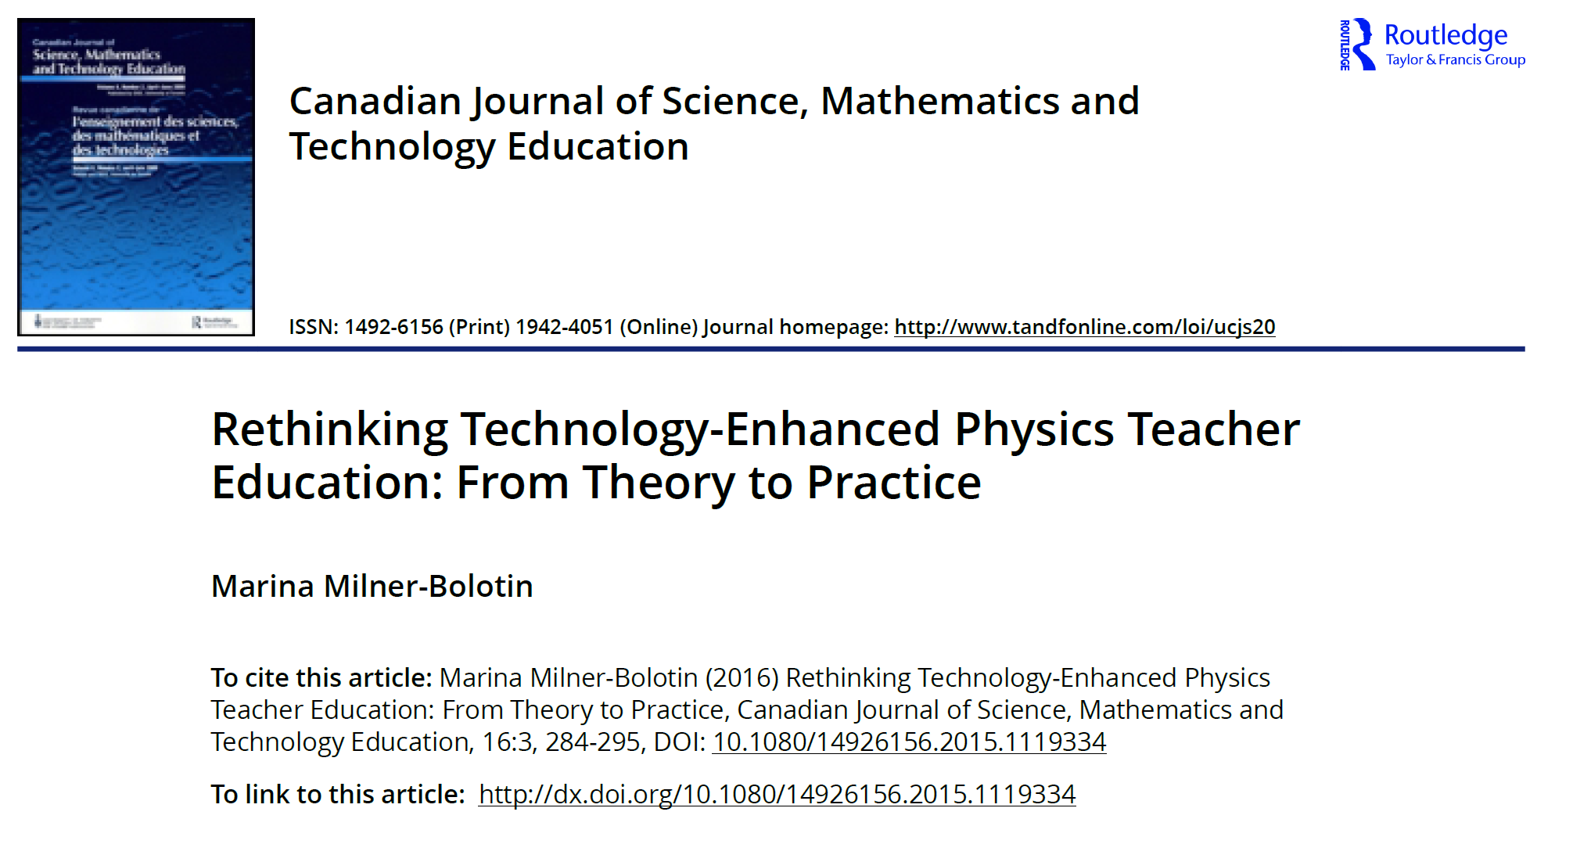
[M. Milner-Bolotin, "Rethinking technology-enhanced physics teacher education: From theory to practice", Canadian Journal of Science, Mathematics and Technology Education, 16, 284-295 (2016).]

Slide 8
Does technology presence guarantee improved student learning?

