Slide 1
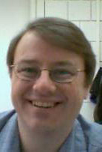
An Online Lab Effort
Stony Brook University
Nicole Cronin
Dr. Thomas Hemmick

Slide 2
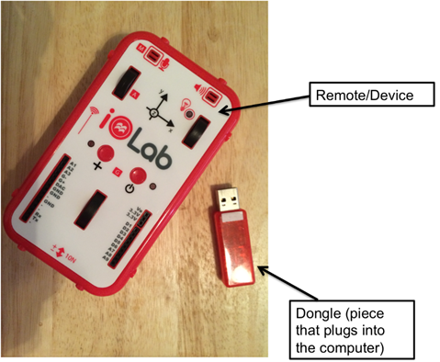
The Process
iOLab Device: From University of Illinois at Urbana Champaign
At Stony Brook:
2 lab classes: PHY 133 & 134
Online lecture
Summer 2016: Developed labs
Fall 2016: Pilot class with 29 students
Notes:
Dr. Hemmick developed the online lecture portion 2 years ago. Now that is up and running smoothly
Stony Brook has made a major push towards online classes

Slide 3
List of Labs for PHY 133
Linear kinematics
Forces and Acceleration
Frictional Force
Springs
Circular Motion
Conservation Laws**
Simple Harmonic Motion
Standing Waves**
Speed of sound**
Thermodynamics**
**Labs developed at Stony Brook

Slide 4
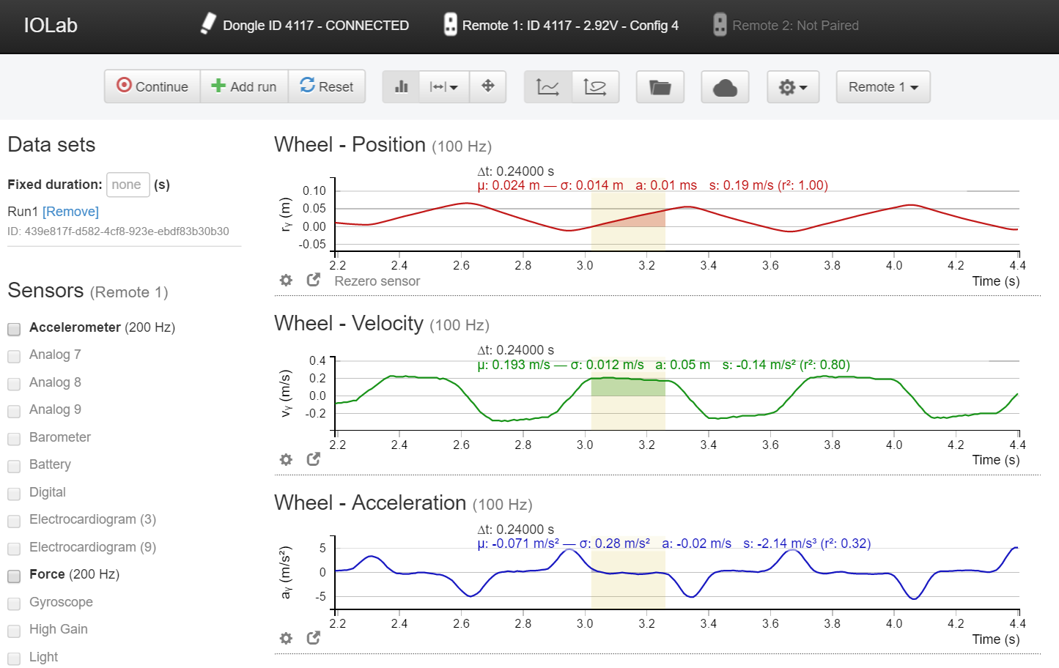
Structure of the Class
Buy the iOLab device/ accessory kit
View the lab manual through lesson player
Imbedded videos and pictures
Do labs at home
Hand in lab reports through Blackboard
Lab quiz after the lab

Slide 5
Lab Goals
According to the 2007 NSTA Position Statement
Design investigations
Engage in scientific reasoning
Manipulate equipment
Record accurate data
Analyze results
Discuss their findings
Adopted as our project goals;
Focus of our feedback data

Slide 6
Lab Goals
1 = strongly disagree
5 = strongly agree
<3.87>
<3.61>
<3.60>
<3.69>
<4.00>
<4.13>
1 2 3 4 5
1 2 3 4 5
1 2 3 4 5
1 2 3 4 5
1 2 3 4 5
1 2 3 4 5

Slide 7
Labs are Fun
Labs Help to Understand Concepts
1 = strongly disagree
5 = strongly agree

Slide 8
Choosing Online Lab Again
Workload Comparison
1 = strongly disagree
5 = strongly agree
1 = much lighter
5 = much heavier

Slide 9
Student Feedback
What they enjoyed
What needs improvement
Fun
Flexible
Opportunity to retake data
More accurate results
Device was easy to use
More student interaction
More in depth videos
More in depth instruction

Slide 10
Future Work
Ongoing: Pilot class for PHY 134
41 students
Revise lab manuals
Going live in Summer of 2017
250 students

Slide 11
List of Labs for PHY 134
Electric Field Plotting**
Ohm’s Law
Kirchoff’s Laws**
RC Circuits
Magnetic Field
Solenoid Field
Faraday’s Laws
RL and RLC Circuits**
Snell’s Law
Diffraction**
**Labs developed at Stony Brook

Slide 12
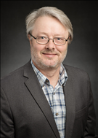
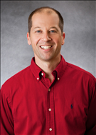
Thank You!
Dr. Thomas Hemmick
Special Thanks to Mats Selen and Tim Stelzer, developers of the ioLab device used in our efforts

Slide 13
