Slide 1
UTeach and PhysTEC, a Winning Combination
Gay and John Stewart
304.293.5030 stem.center@mail.wvu.edu

Slide 2
Institutional Contexts
University of Arkansas, Fayetteville (UAF) is the primary land-grant institution in Arkansas, with the only PhD program in physics in the state. Enrollment ~25,000. About 30 undergrads graduate each year in physics.
West Virginia University (WVU) is the primary land-grant institution in West Virginia, with the only PhD program in physics in the state. Enrollment ~30,000. About 15 undergraduates graduate each year in physics.
Although “Mountaineers go first” will talk about Arkansas first. Both states have large low SES population, so paying for an extra year of school to teach is a major barrier that UTeach solves.

Slide 3
UAteach/PhysTEC Background
UA was a PhysTEC legacy site and completing the second year of a UTeach program when we left in 2014.
The decision to adopt UTeach as a model in the state was made by the governor, summer 2011. Previously very strong resistance to a four-year program by the College of Education and Health Professions (CEHP)
UAteach is co-directed by a PhysTEC director, an assistant dean from the College of Engineering, and a faculty member from the CEHP
UAteach, officially announced July 2012, offered Step 1 Fall 2012 (72); Step 1 (30), Step 2 (35) and Knowing and Learning (8) Spring 2013. First 3 graduates spring 2014 (all physics). Remained in 5+ Club 2015, but only 4 physics teachers last year.

Slide 4
Challenges
Friction between colleges mitigated by third director from a different college who had sympathy for physics.
Budget issues (state exaggerated the help they would offer)
Initial adequate instructional support (CEHP exaggerated…)
Getting all the paperwork through for certification (state exaggerated the help they would offer)

Slide 5
Good stuff
UAteach designed based on PhysTEC experience: how to incorporate the best of the TIR into the MT
Looked at full role of all MTs in a mature UTeach program and built the induction and mentoring into all of the MT job descriptions, instead of having separate staff.
Statewide competition for limited resources: we didn’t get enough, but we got really good reviews based on PhysTEC so Physics got to influence UAteach strongly
Noyce grant was ending, so needed a way to reduce burden of choosing teaching as a career!

Slide 6
Sustaining PhysTEC with UTeach?
PhysTEC activities that must be sustained (easier for UA since already post funding and had figured out how to do with less):
Reformed content courses
Provost had already guaranteed, based on improvement in student success
Mentoring (been scrounging for) and recruitment (new) activities: built into UAteach
UAF LAs were never funded
Works both ways:
PhysTEC Teacher Advisory Group
Becomes a core of strong mentor teachers

Slide 7
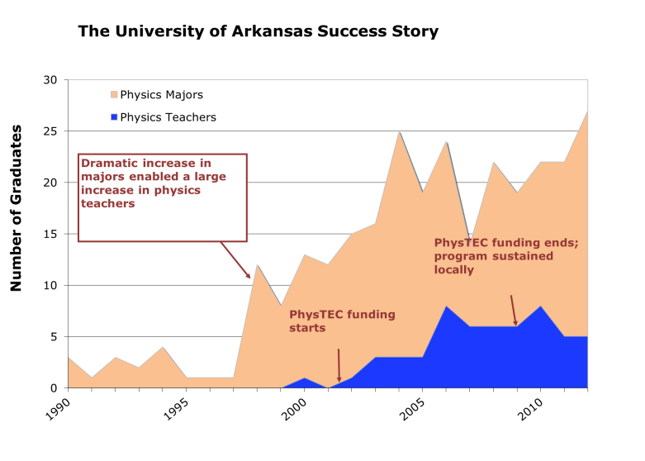
Notes:
Hopefully steady between 4-6

Slide 8
WVU
1 physics teacher in last 15 years
Now nine in the pipeline…
Revised physics courses leading to larger learning gains and smaller failure rates
Engineering is recruiting for WVUteach because physics is a good partner, and engineers most likely prepare to teach physics or math.
Started slow…

Slide 10
1.5 years of TiR let us develop physics-specific recruiting and to revise LA program structure. The classic model wasn’t working.
TiR supported course transformation and will join the department’s advising team leading new student advising in the summers.
TiR becomes a Master Teacher, so no time left to help in physics, but ideal mentor for student and early-career physics teachers and a voice for physics in all WVUteach faculty meetings.
Still getting courses how we want them-but the revised third- semester course rolled out this semester. BIG DEAL.
97 students in WVUteach; roughly 26% bio, 17% chemistry, 16% engineering, 10% math, 6% forensic science, 5% physics, scattering of geology and undeclared. We have pathways to physics licensure for chemistry, engineering and math.
Four students should graduate in 2018, at least three will be well prepared to teach physics. (Two math, one engineering, one physics major)

